Slide 1
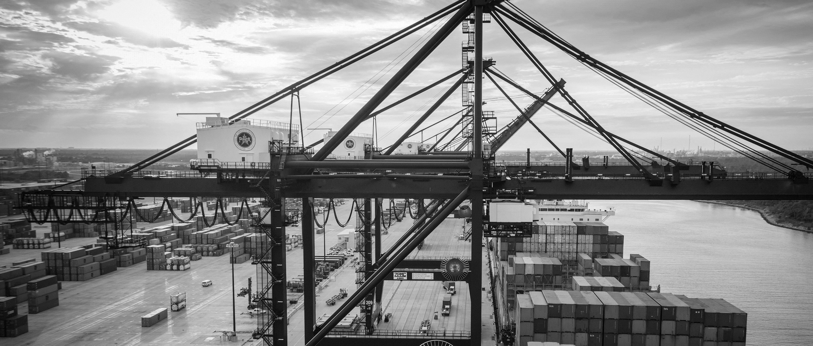
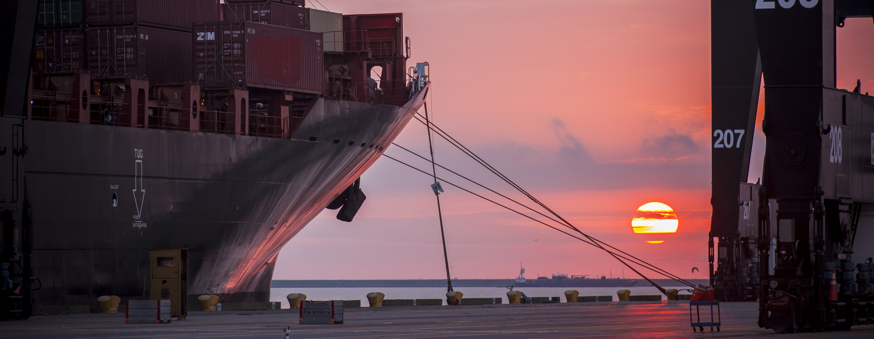
CSB - 577 Repair of Storm Water Trench Drains at Bayport Container Terminal

Slide 2
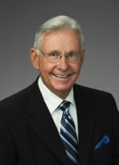
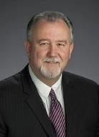
Port Commission
John D. Kennedy
Dean E. Corgey
Clyde Fitzgerald
Janiece M. Longoria
Chairman
Theldon R. Branch, III
Stephen H. DonCarlos
Roy D. Mease
WELCOME MESSAGE | 2

Slide 3
CSB – Repair of Storm Water Trench Drains at Bayport Terminal
AGENDA
Introductions
Harris County
Small Business
Procurement Services
Selection Criteria
Questions
All attendees must sign-in and indicate attendance for site visit and TWIC cardholders

Slide 4
CSB – Repair of Storm Water Trench Drains at Bayport Terminal
PHA Personnel:
Roger H. Hoh, P.E. – Director, PCM
Nick Kotsatos, P.E. –Construction Manager
Barbara Smith, P.E. – Project Manager
Randy Stiefel – Director of General Cargo
Klotz
Martin Gonzalez, P.E. – Klotz
Harris County:
Robert Rocha – Wage Rate Monitor

Slide 5
CSB – Repair of Storm Water Trench Drains at Bayport Terminal
Harris County Wage Rate Compliance & Requirements:
Attendance at pre-bid/proposal meetings and pre-construction meetings
Review and approve weekly certified payroll records
Monitor wage rate compliance
Review claims of non-compliance from the field and recommend appreciate responses as required or permitted under the Wage Scale Act

Slide 6
CSB – Repair of Storm Water Trench Drains at Bayport Terminal
Small Business Requirement:
Participation Goal Small Business is 0% of the Purchase Price

Slide 7
CSB – Repair of Storm Water Trench Drains at Bayport Terminal
Procurement:
Competitive Sealed Bid (CSB) are due on December 20, 2017, no later than 11:00 A.M.
One original and five copies, packaged in one sealed envelope
All bids will be opened and read publicly in the PHA first floor conference room by Procurement Services on Wednesday, December 20, 2017 at 11:30 A.M.

Slide 8
CSB – Repair of Storm Water Trench Drains at Bayport Terminal
Selection Criteria
The Port Commission will award the contract to the responsible bidder submitting the lowest and best proposal.
Responsible:
Have the ability to comply with the required delivery or performance schedule, taking into consideration other business commitments;
Have a satisfactory record of performance and integrity;
Have satisfactory safety and environmental record;
Have satisfactory references; and
Have the necessary facilities, equipment, materials, personnel, organization, experience, authorizations, technical skills, and financial resources to fulfill the terms of the contract for the project

Slide 9
CSB – Repair of Storm Water Trench Drains at Bayport Terminal
Competitive Sealed Bid/ Response:
Page 2 – Required Attachments

Slide 10
CSB – Repair of Storm Water Trench Drains at Bayport Terminal
General Scope of Services:
SWPPP
Traffic Control
Demolition
Construction

Slide 11
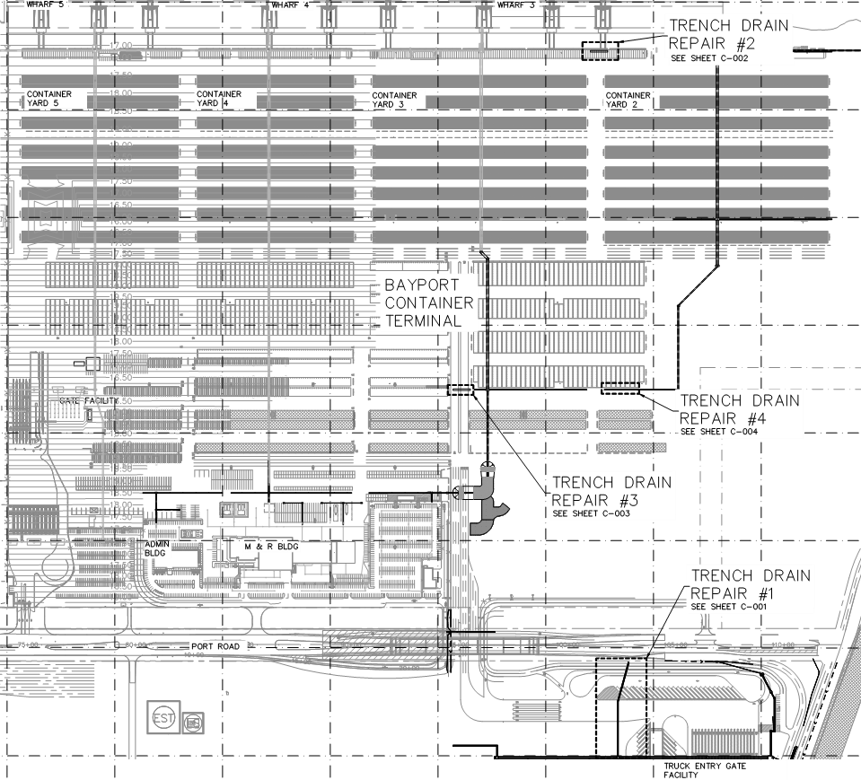
CSB – Repair of Storm Water Trench Drains at Bayport Terminal
General Scope of Services (continued):

Slide 12
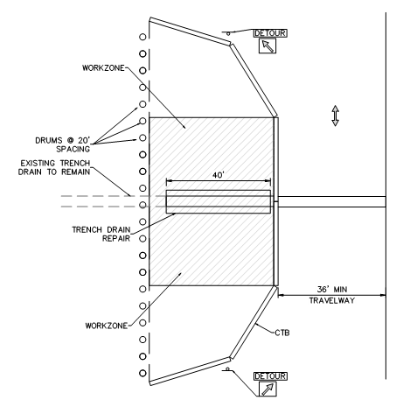
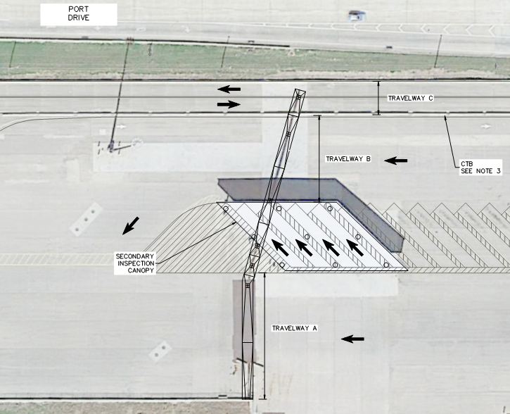
CSB – Repair of Storm Water Trench Drains at Bayport Terminal
General Scope of Services (continued):
Traffic Control
Location #1 – Follow TCP detail or similar, Maintain traffic in all travelways
Locations #2, 3 and 4 – Construct in halves, maintain 36’ minimum travelway

Slide 13
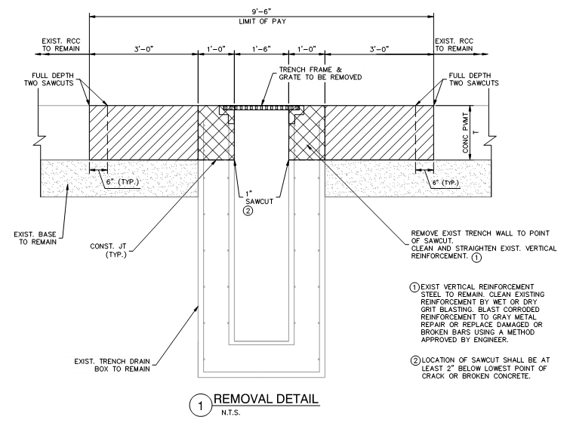
CSB – Repair of Storm Water Trench Drains at Bayport Terminal
General Scope of Services (continued):

Slide 14
CSB – Repair of Storm Water Trench Drains at Bayport Terminal
No photographs – leave cell phones in your pockets or purses
Stay with group
PHA certified TWIC escorts must accompany individuals without a TWIC card
Safety vests, hard hat, safety glasses
No open-toed shoes
Personal flotation devices if within 20’ of face of wharf
Comply with your company’s safety policy

Slide 15
THANK YOU
Barbara Smith, P.E.
Project Manager
Port Houston
Questions?
www.PortHouston.com
111 East Loop North
Houston, TX 77029

