Slide 1

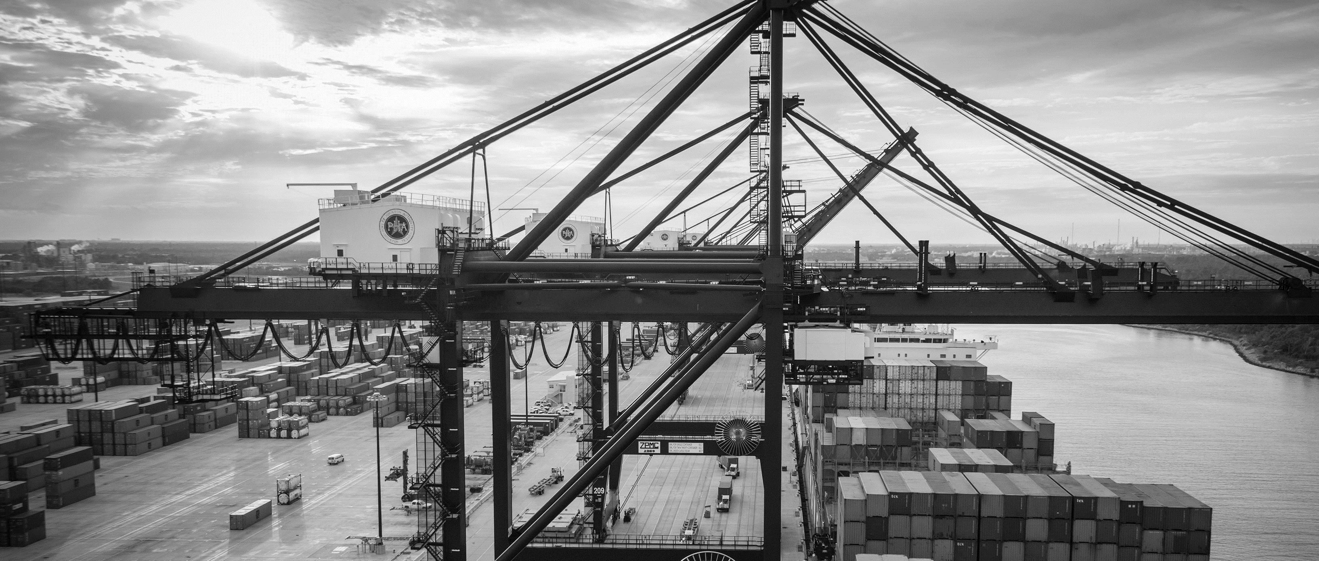
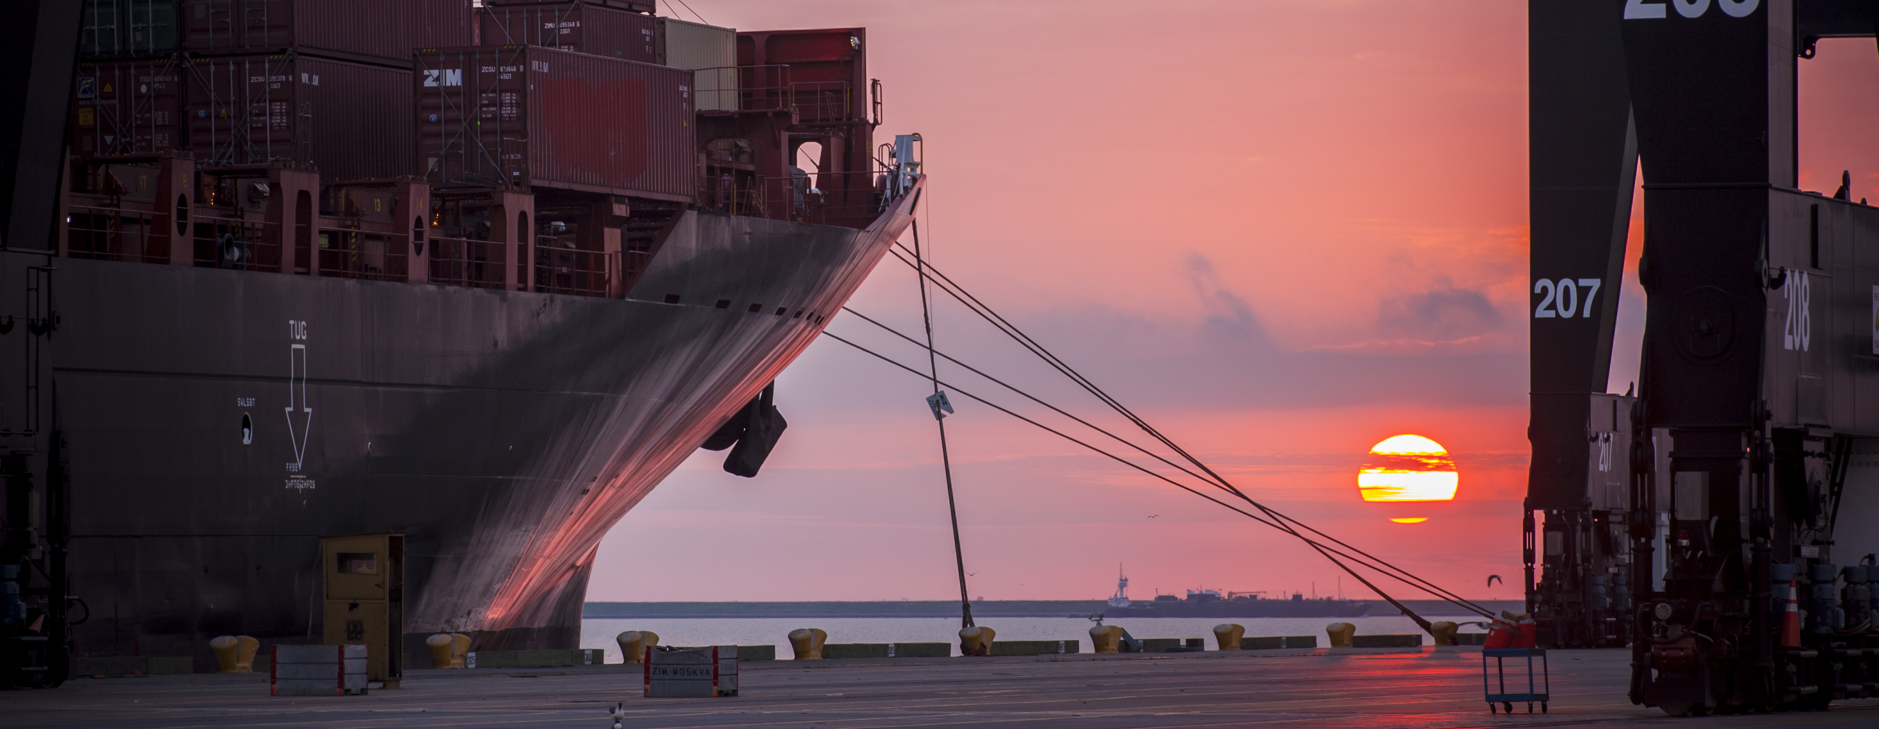
CSB – Stevedore Support Buildings 2 & 3 Repairs at Bayport Container Terminal
Brenda C Trevino, P.E. | Project Manager | Project & Construction Management (PCM)

Slide 2
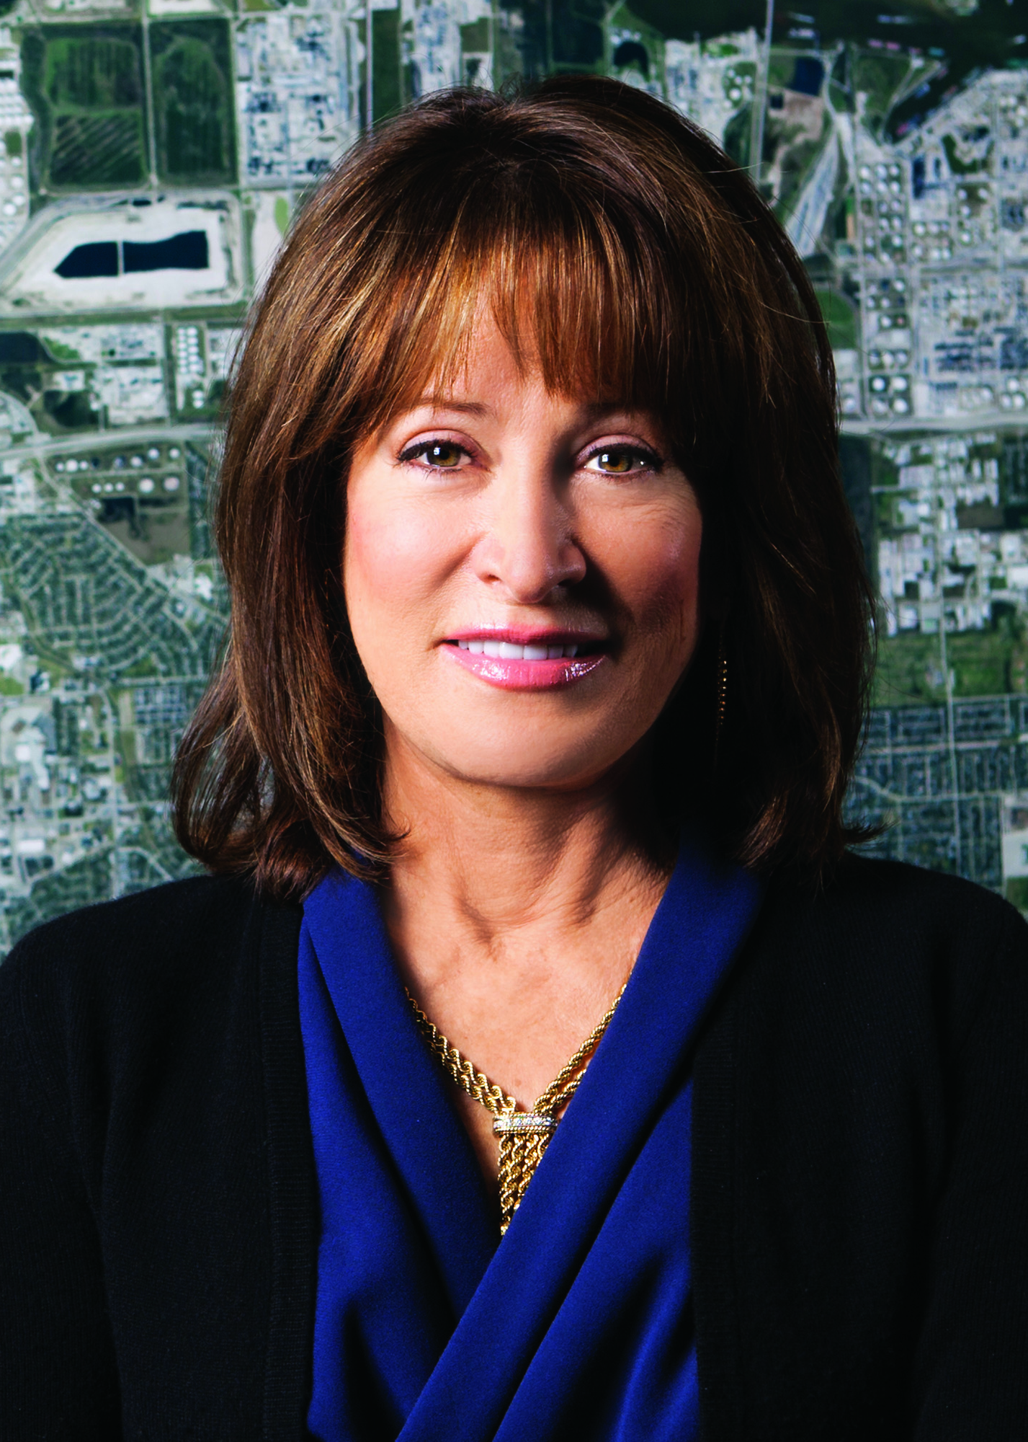
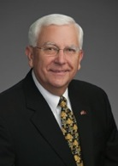
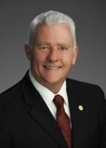
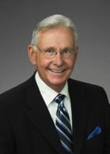
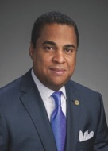
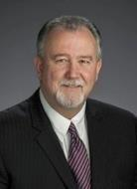
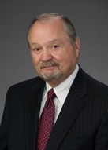
Port Commission
John D. Kennedy
Dean E. Corgey
Clyde Fitzgerald
Janiece M. Longoria
Chairman
Theldon R. Branch, III
Stephen H. DonCarlos
Roy D. Mease
WELCOME MESSAGE | 2

Slide 3
CSB- Stevedore Support Buildings 2&3 RepairsStevedore Support Buildings 2 & 3 Repairs at Bayport CSB- Container Terminal
AGENDA
Introductions
Harris County
Small Business
Procurement Services
Selection Criteria
[Site] Parameters
Questions
All attendees must sign-in and indicate attendance for site visit and TWIC cardholders

Slide 4
CSB- Stevedore Support Buildings 2&3 RepairsStevedore
PHA Personnel:
Roger H. Hoh, P.E. – Director, PCM
Nick Kotsatos, P.E. –Construction Manager
Brenda C. Trevino, P.E. – Project Manager
Pedro Gonzales – Small Business Development
Ryan Mariacher– Director of Container Terminals
Harris County:
Robert Rocha – Wage Rate Monitor

Slide 5
CSB- Stevedore Support Buildings 2&3 RepairsStevedore
Harris County Wage Rate Compliance & Requirements:
Attendance at pre-bid/proposal meetings and pre-construction meetings
Review and approve weekly certified payroll records
Monitor wage rate compliance
Review claims of non-compliance from the field and recommend appreciate responses as required or permitted under the Wage Scale Act

Slide 6
CSB- Stevedore Support Buildings 2&3 RepairsStevedore
Small Business Requirement:
Participation Requirement for Small Business is 15% of the Purchase Price
If Small Business Participation does not meet or exceed 15%, the bid will not be considered.

Slide 7
CSB- Stevedore Support Buildings 2&3 RepairsStevedore
Procurement:
Competitive Sealed Bid (CSB) are due on July 19, 2017, no later than 11:00 A.M.
One original and five copies, packaged in one sealed envelope
All bids/proposals will be opened and read publicly in the PHA first floor conference room by Procurement Services on Wednesday, July 19, 2017 at 11:30 A.M.

Slide 8
CSB- Stevedore Support Buildings 2&3 RepairsStevedore
Selection Criteria
The Port Commission will award the contract to the responsible bidder/proposer submitting the lowest and best proposal.
Responsible:
Meet the applicable Small Business Participation requirements, if any;
Have the ability to comply with the required delivery or performance schedule, taking into consideration other business commitments;
Have a satisfactory record of performance and integrity;
Have satisfactory safety and environmental record;
Have satisfactory references; and
Have the necessary facilities, equipment, materials, personnel, organization, experience, authorizations, technical skills, and financial resources to fulfill the terms of the contract for the project

Slide 9
CSB- Stevedore Support Buildings 2&3 RepairsStevedore
Competitive Sealed Bid/ Proposal Response:
Page 2 – Required Attachments

Slide 10
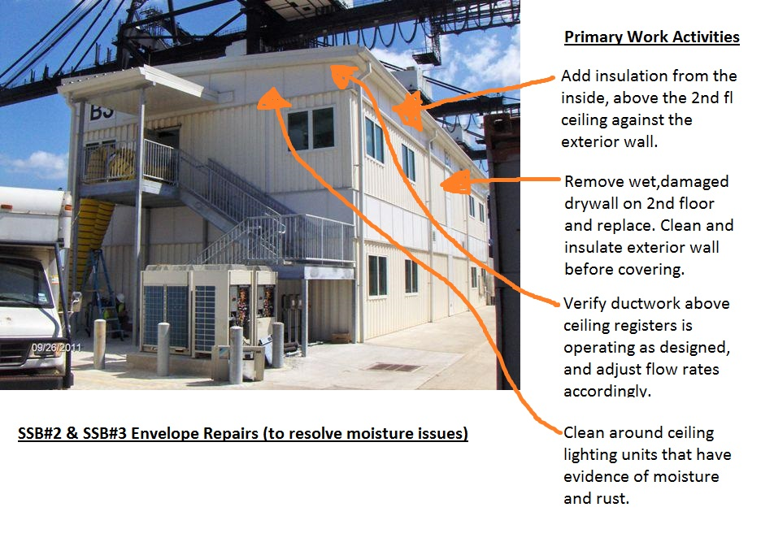
CSB- Stevedore Support Buildings 2&3 RepairsStevedore
You Are Here

Slide 11
CSB- Stevedore Support Buildings 2&3 RepairsStevedore
General Scope of Services:
Detail: Seal the building envelope at each of the two buildings, to prevent moisture buildup form the inside. Re-set the HVAC systems controls to prevent future issues with moisture and to protect and preserve the asset adequately.
The work includes: remove and replace gypsum board with past water damage. Leave the equipment and framework above the ceiling clean and dry. Add insulation and seal the exterior walls above the ceiling. Verify ductwork and valves are operating correctly and modify as instructed. (all on the 2nd floor)

Slide 12
CSB- Stevedore Support Buildings 2&3 RepairsStevedore
General Scope of Services (continued):
Remove fan and seal opening

Slide 13
CSB- Stevedore Support Buildings 2&3 RepairsStevedore
General Scope of Services (continued):
Building Section-1 Typical Level One and Two
As indicated in the building section, the level one area is completely separated from the
second level by the concrete second floor deck supported by the level 1 steel joists.

Slide 14
CSB- Stevedore Support Buildings 2&3 RepairsStevedore
No photographs – leave cell phones in your pockets or purses
Stay with group
PHA certified TWIC escorts must accompany individuals without a TWIC card
Safety vests, hard hat, safety glasses
No open-toed shoes
Personal flotation devices if within 20’ of face of wharf
Comply with your company’s safety policy

Slide 15
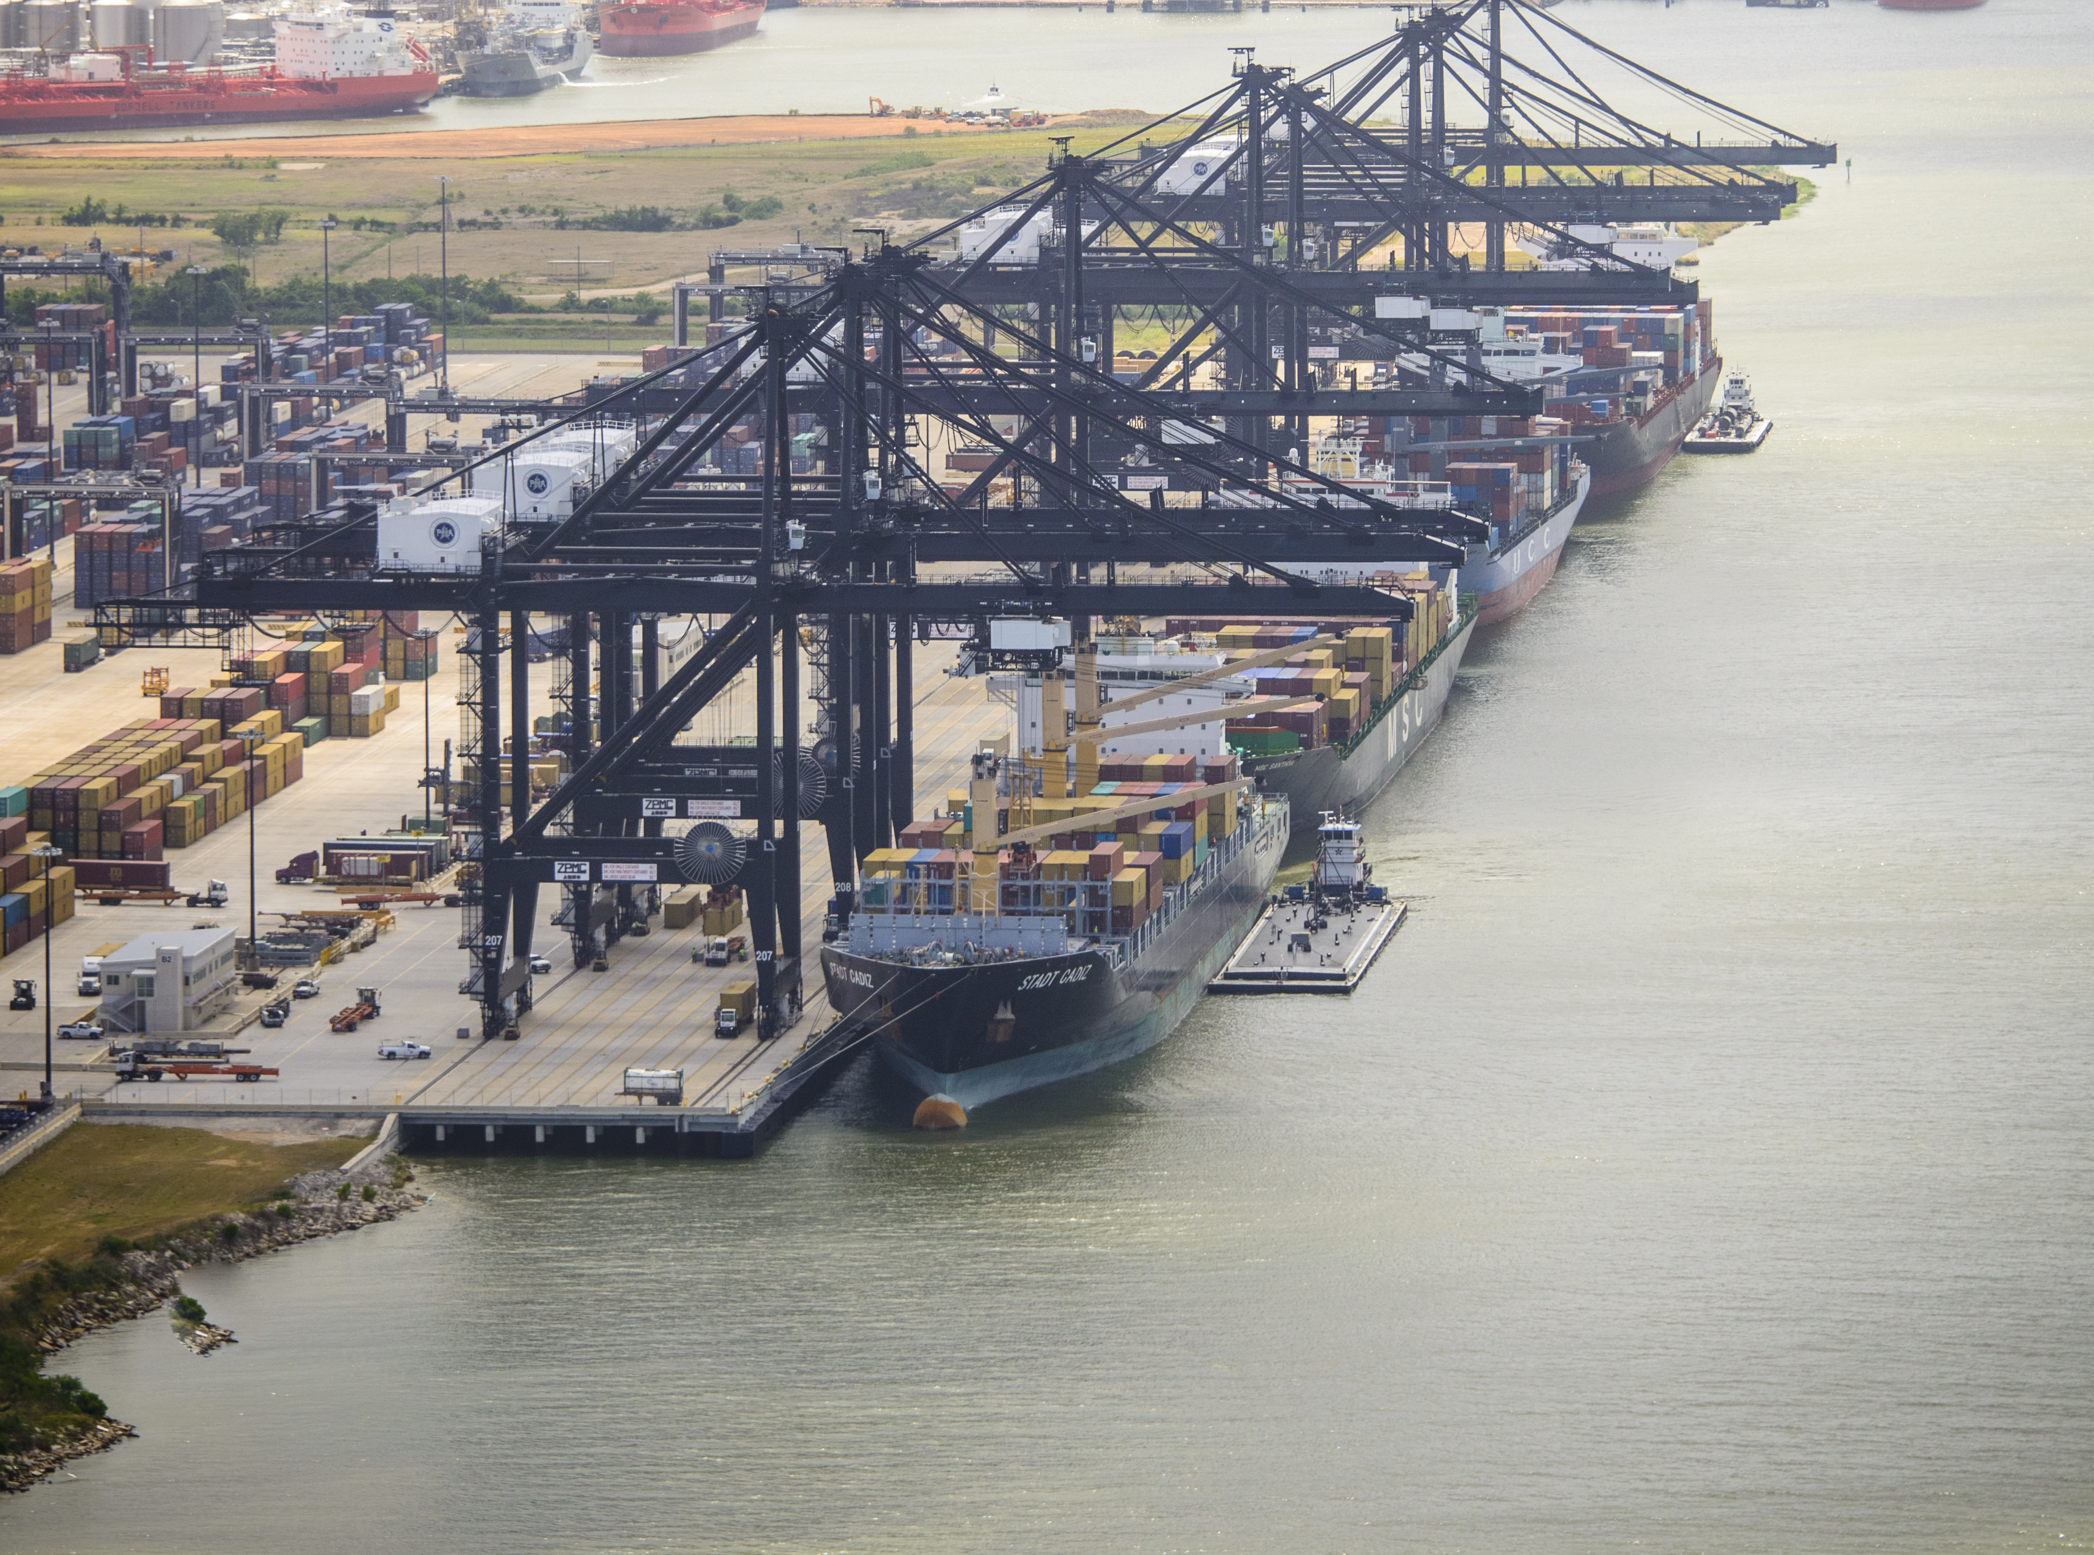
THANK YOU
Brenda C Trevino, P.E.
Project Manager
Port Houston
Questions?
www.PortHouston.com
111 East Loop North
Houston, TX 77029

