Slide 1
CSB-1964 TRASH DISPOSAL AND RECYCLING SERVICES
PRE-BID CONFERENCE:
August 17, 2021
1:00 p.m. (CST)

Slide 2
AGENDA
Pre-Bid Conference House Rules
Port Commission
Business Equity
Procurement Services
Scope of Services
Q/A

Slide 3
PRE-BID CONFERENCE HOUSE RULES
Attendees will begin the meeting in listen-only mode.
There will be a Q&A session at the end of today’s presentation.
If you have any questions during the presentation, you may submit your Questions through the WebEx chat feature and they will be addressed at the end of the presentation.
This presentation will be recorded and posted on the BuySpeed homepage under “Pre-Bid/Proposal Conference Information.”

Slide 4
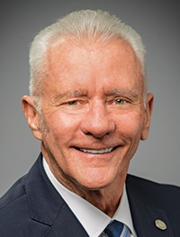
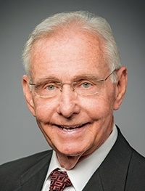
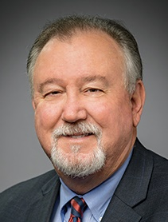
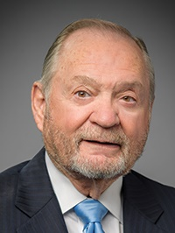
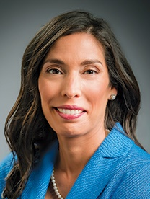
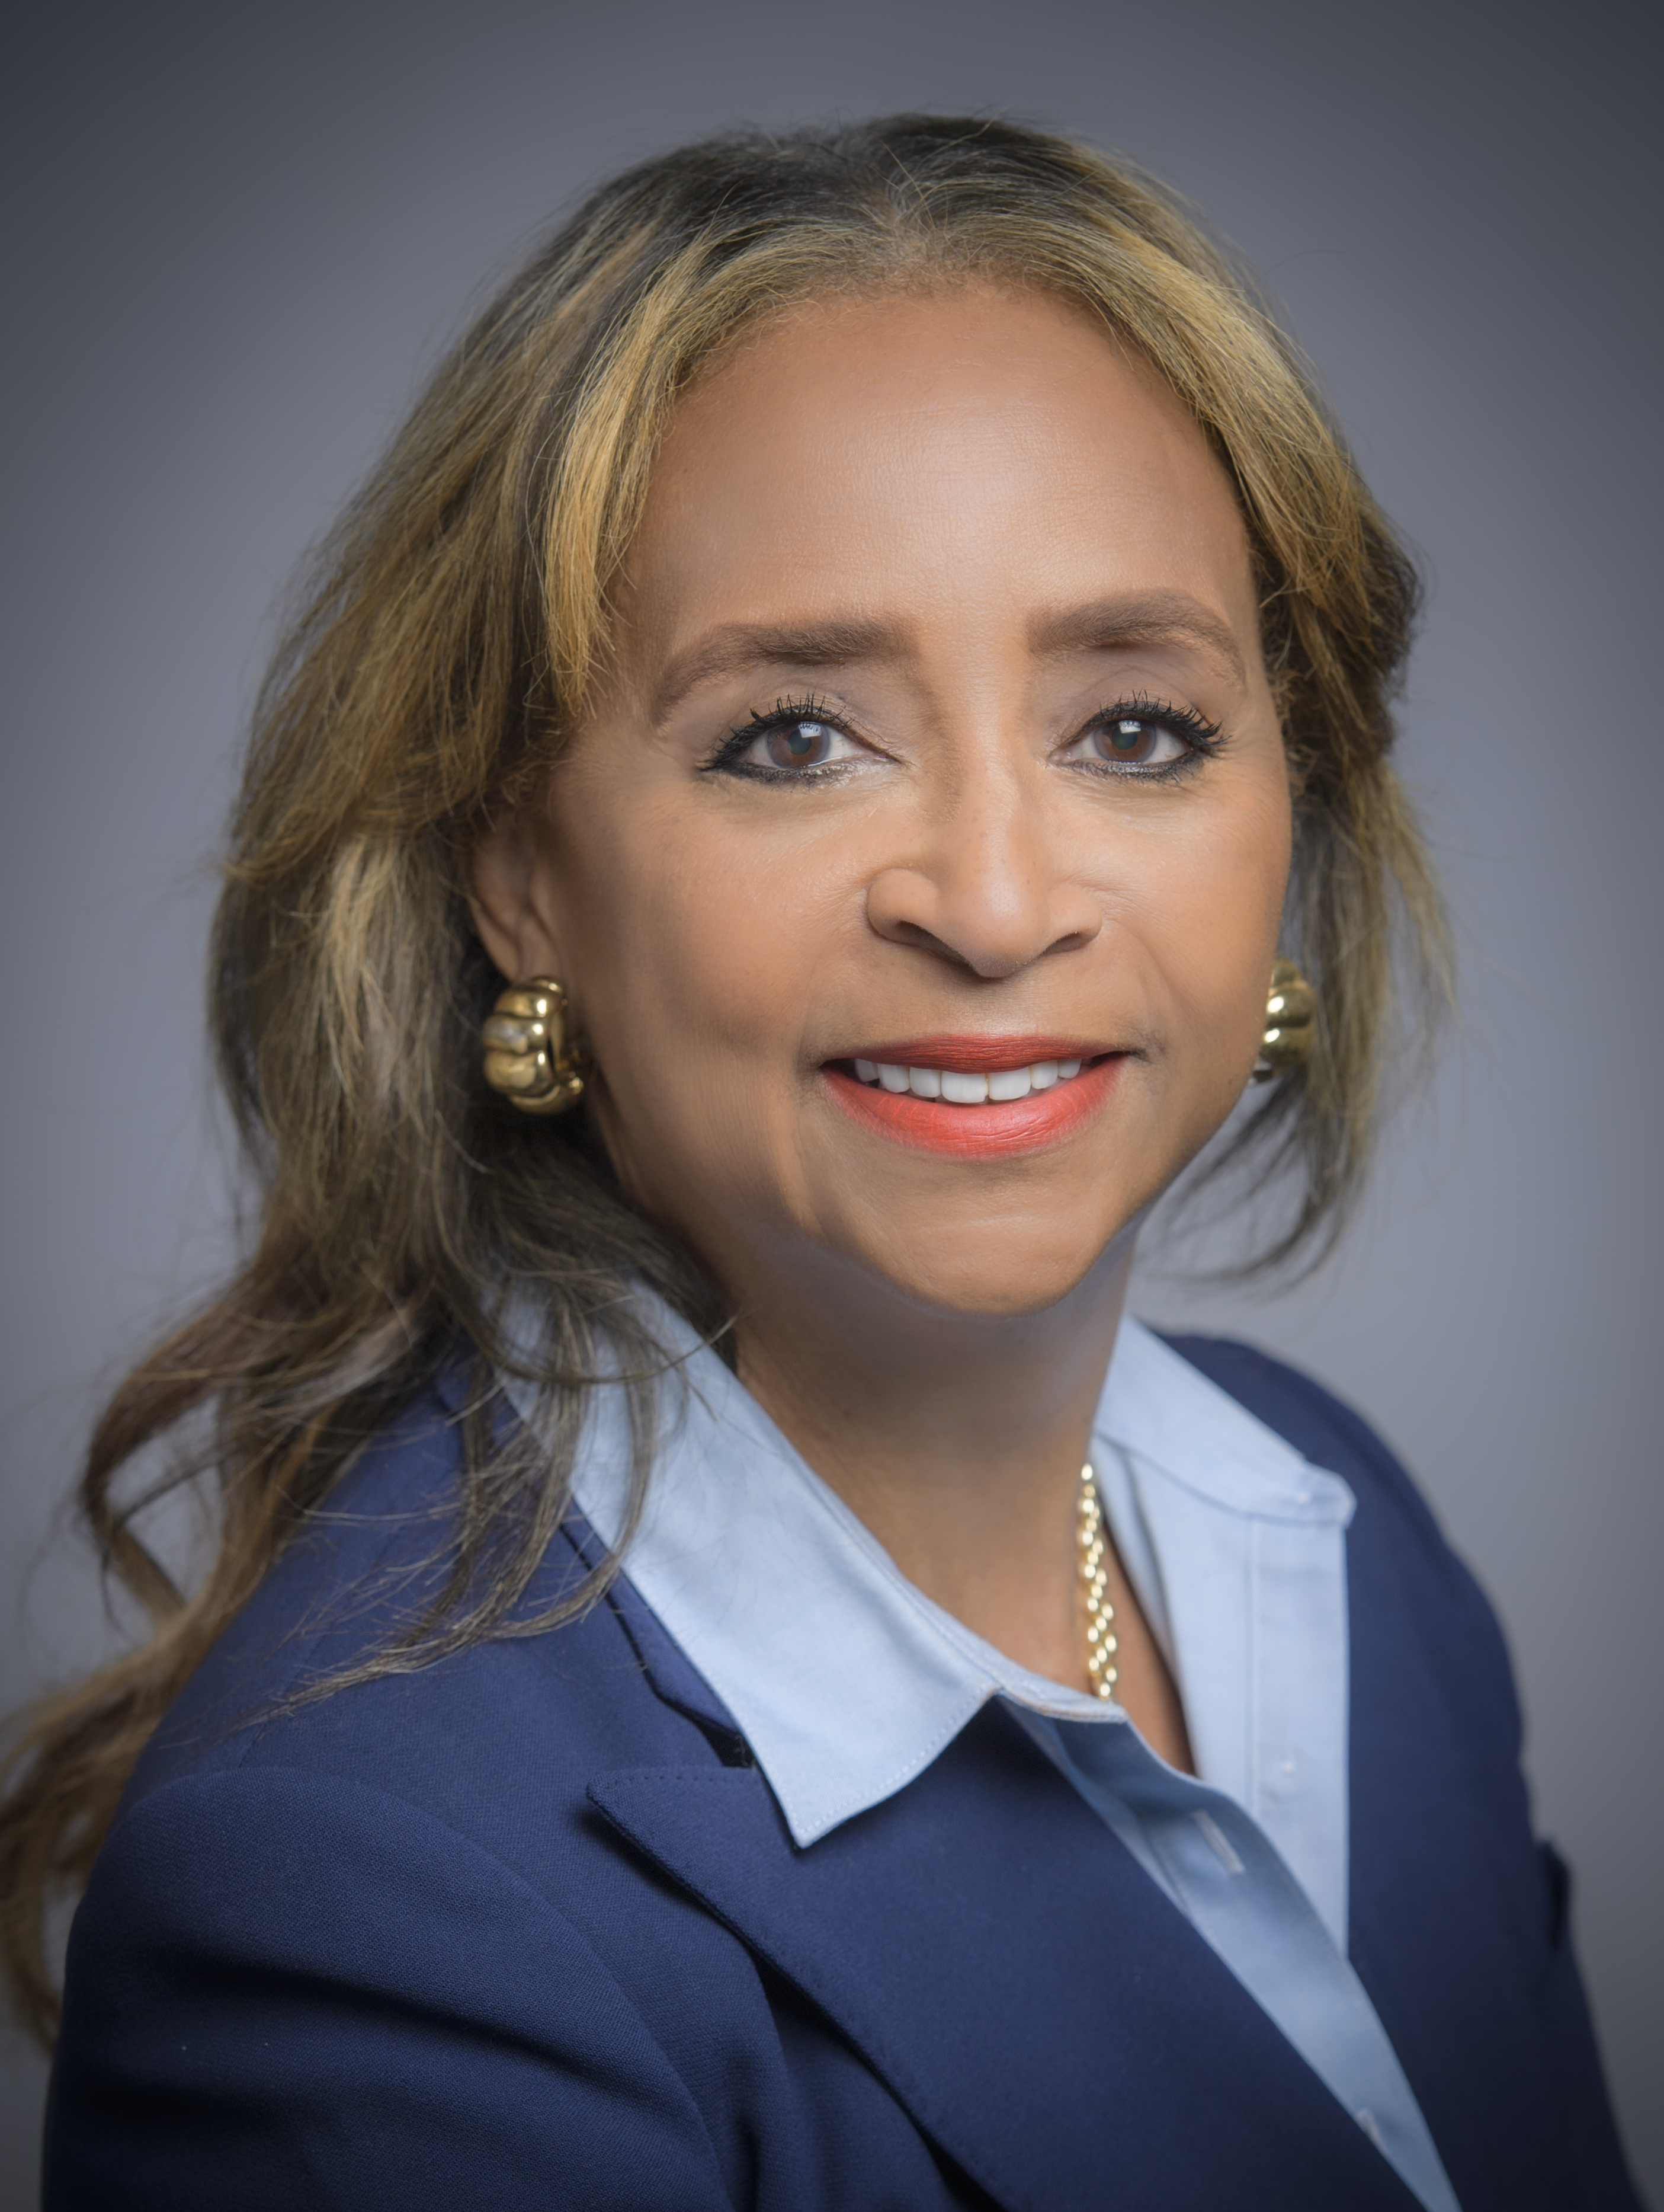
PORT COMMISSION
Dean E. Corgey
Commissioner
Clyde Fitzgerald
Commissioner
Stephen H. DonCarlos
Commissioner
Ric Campo
Chairman
Roy D. Mease
Commissioner
Wendy Montoya Cloonan
Commissioner
Cheryl D. Creuzot
Commissioner
Notes:
So let’s talk about Port Houston. First, we are governed by a seven-member Commission, led by Chairman Ric Campo.

Slide 5
Business Equity
CSB-1954 Trash Disposal and Recycling Services
Pedro Gonzalez, P.E.,
Manager, Mentoring Program

Slide 6
BUSINESS EQUITY, S/MWBE INITIATIVE
The New Business Equity Division provides resources to small, minority- and woman-owned businesses (S/MWBE) seeking to participate in Port Houston procurements and contracts
Our goal is to maintain a 35% overall Small Business (SBE) participation and aspire to reach a 30% Minority- and Woman-Owned Business (MWBE) participation
Notes:
The Port Commission, at its April 27, 2021 meeting, approved the NEW Minority- and Woman-Owned Business Enterprise Development Policy and the Amended and Restated Small Business Development Policy.
Initiative will reduce barriers to MBEs and WBEs who want to engage in business with Port Houston
Port Houston is working to identify and contact qualified S/MWBEs to meet our participation goals
Implemented race- and gender-neutral measures to ensure equal opportunities for all contractors and subcontractors
Port Houston is continuing to provide training, mentorship, networking and development assistance to all S/MWBEs

Slide 7
BUSINESS EQUITY
Small Business Enterprise (SBE)
Small Business Enterprise “SBE” means a firm whose gross revenues or number of employees, averaged over the past three years, inclusive of any affiliates as defined by 13 CFR § 121.103, does not exceed the size standards defined in Section 3 of the Federal Small Business Act and applicable Small Business Administration regulations related to the size standards found in 12 CFR §121. The net worth of the owner must be less than $1.32 million, excluding the owner’s primary residence and assets of the business.
Minority Business Enterprise (MBE)
Minority-Owned Business Enterprise “MBE” means a Business that is at least 51% Owned by one or more Minority Persons, or for which at least 51% of the equity is Owned by one or more Minority Persons, and both the management and daily business operations are carried out and controlled by one or more of the Minority Persons who own it.

Slide 8
BUSINESS EQUITY
Woman Business Enterprise (WBE)
Woman-Owned Business Enterprise “WBE” means a Business that is at least 51% Owned by one or more female American citizens, or for which at least 51% of the equity is Owned by one or more female American citizens, and both the management and daily business operations are carried out and controlled by one or more of the female American citizens who own it.
MWBE and SBE Policies
The Port Commission, at its April 27, 2021 meeting, approved the NEW Minority- and Woman-Owned Business Enterprise Development Policy and the Amended and Restated Small Business Development Policy.

Slide 9
PARTNER AGENCIES
Small and MWBEs must meet certain criteria and be certified with one of the following partner Agencies:
*City of Houston (SBE, MBE, WBE)
Houston Minority Supplier Development Council (MBE)
*METRO (SBE)
*SBA 8(a) (SDB)
*State of Texas HUB Certification (HUB)
South Texas Central Regional Certification Agency (SBE,
MBE, WBE)
*Texas Department of Transportation (SBE)
Women’s Business Enterprise Alliance (WBE)
*No fee to apply

Slide 10
SMALL BUSINESS REQUIREMENT
Contractor is encouraged to and agrees it will endeavor to:
Placing qualified small and minority businesses and women’s business enterprises on solicitation lists;
(2) Assuring that small and minority businesses, and women’s business enterprises are solicited whenever they are potential sources;
(3) Dividing total requirements, when economically feasible, into smaller tasks or quantities to permit maximum participation by small and minority businesses, and women’s business enterprises;
(4) Establishing delivery schedules, where the requirement permits, which encourage participation by small and minority businesses, and women’s business enterprises;
(5) Using the services and assistance, as appropriate, of such organizations as the Small Business Administration and the Minority Business Development Agency of the Department of Commerce; and
(6) Requiring the prime contractor, if subcontracts are to be let, to take the affirmative steps listed in paragraphs (b)(1) through (5) of this section.

Slide 11
SMALL BUSINESS REQUIREMENTS
1) Place qualified small businesses and MWBEs on subcontractor and supplier solicitation lists;
2) Attempt to solicit small businesses and MWBEs whenever they are potential participants in the Work;
3) Divide total work requirements, when economically feasible, into smaller tasks or quantities to permit maximum participation by small businesses and MWBEs;
4) Establish delivery schedules, where requirements permit, which encourage participation by small businesses and MWBEs; and
5) Use the services and assistance, as appropriate, of the Port Authority’s Business Equity Division in such aspirational efforts.

Slide 12
Procurement Services
CSB-1954 Trash Disposal and Recycling Services
Tanika Chukwumerije,
Manager, Contracts

Slide 13
PROCUREMENT
No Contact Period- No communication between interested vendors and PHA staff during the active period
Technical questions should be submitted via Buyspeed
Last day to submit questions- 7 days before due date (9/8/2021)
Responses are due no later than 11 a.m. on 9/15/2021
Proposals must be submitted electronically via email to: procurementproposals@porthouston.com
Use forms in the package
Anticipated award date: 10/26/2021

Slide 14
PROCUREMENT
Evaluation Criteria
The Port Commission will award the contract to the Responsible bidder submitting the lowest and best bid.
In determining whether a bidder qualifies as “responsible” (i.e., eligible for award), a number of factors, including but not limited to the following, may be considered. A responsible bidder should:
1. meet the applicable small business participation requirements, if any and
2. have the ability to comply with the required delivery or performance schedule, taking into consideration other business commitments;
3. have a satisfactory record of performance and integrity;
4. have a satisfactory safety and environmental record; and
5. have satisfactory references; and
6. have the necessary facilities, equipment, material, personnel, organization, experience, authorizations, technical skills, and financial resources to fulfill the terms of the contract for the Project.

Slide 15
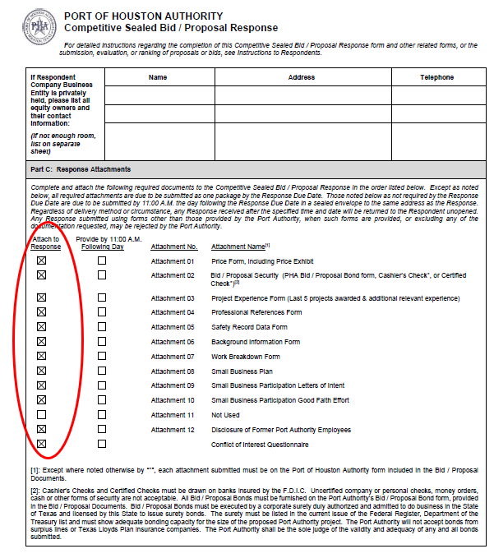
PROCUREMENT
Proposal Response form:
(Page 32 of CSB package)
Page 2 of the Competitive Sealed Bid/Proposal Response Form – Required Attachments

Slide 16
Scope of Services
CSB-1954 Trash Disposal and Recycling Services
Christopher Conti,
Facilities Manager

Slide 18
CSB-1964 Trash Disposal and Recycling Services
QUESTIONS?

