Slide 1
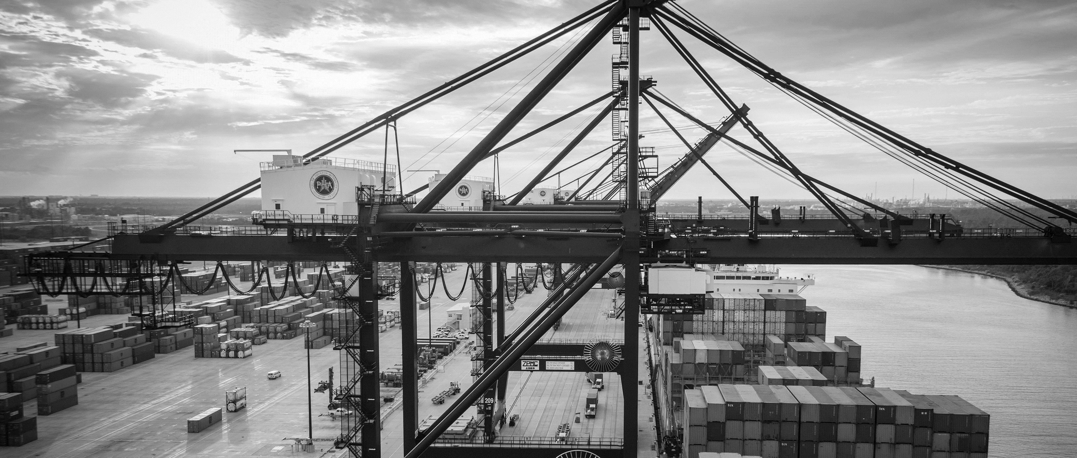
Annual Perimeter Fence Security Fence Replacement at Turning Basin Terminal 2021
Derek L. Garrett | Project Manager | Project & Construction Management (PCM)

Slide 2
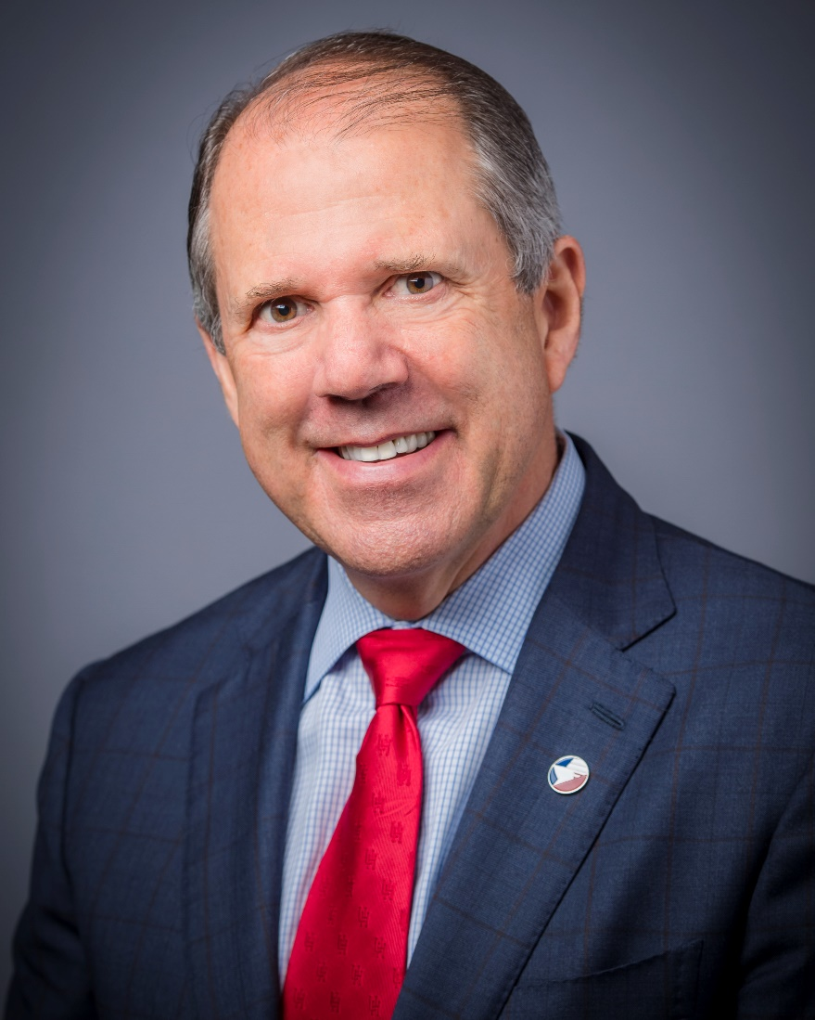
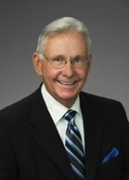
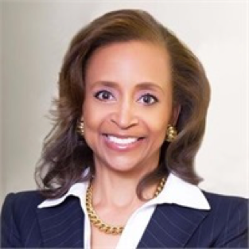
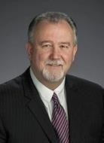
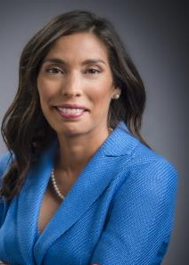
Port Commission
Dean E. Corgey
Clyde Fitzgerald
Cheryl D. Creuzot
Rick Campos
Chairman
Stephen H. DonCarlos
Roy D. Mease
Wendy Montoya
Cloonan
WELCOME MESSAGE | 2

Slide 3
CSB – Perimeter Security Fence TBT
AGENDA
Introductions
Harris County
Small Business
Procurement Services
Selection Criteria
Site Parameters
Questions

Slide 4
CSB – Perimeter Security Fence TBT
PHA Personnel:
Roger H. Hoh, P.E. – Director, PCM
Derek L. Garrett – Project Manager
Ruth Flores P.E. – Construction Manager
Randy Stiefel – Director, General Cargo Facilities
Yvette Camel-Smith – Director, Procurement Services
Pedro Gonzalez, P.E. – Small Business Manager
Harris County:
Robert Rocha – Wage Rate Monitor

Slide 5
CSB – Perimeter Security Fence TBT
Harris County Wage Rate Compliance & Requirements:
Attendance at pre-bid/proposal meetings and pre-construction meetings
Review and approve weekly certified payroll records
Monitor wage rate compliance
Review claims of non-compliance from the field and recommend appreciate responses as required or permitted under the Wage Scale Act
Ruth Flores P.E. – Construction Manager

Slide 6
Small Business What Do We Do?
Small Business Development Program
Provide opportunities for local small businesses to participate in contracting and procurement at Port Houston with 35% overall SB goal.
Outreach Activities
Business-to-Business Connections
Industry Specific Forums
Training & Development Initiatives
Port University
Inter-Agency Mentor Protégé Program
Slide 3

Slide 7
Small Business Enrollment
Businesses must meet certain criteria and be certified with one of Port Houston’s partner agencies
Applies to all contracts over $50,000
Race-and gender-neutral program
Restricted to local small businesses within the 8 counties surrounding Houston (Harris, Montgomery, Waller, Brazoria, Ft. Bend, Galveston, Chambers, Liberty)
The size of the business must not exceed Code of Federal Regulations 49 CFR §26.67 or 13 CFR §124 for small business owners. Visit www.sba. gov/size for more information.
Net worth of the owner must be less than $1.32 million, excluding the owner’s primary homestead and assets of the business.
Slide 5

Slide 8
CSB – Perimeter Security Fence TBT
Small Business Requirement:
Minimum Participation Requirement: Project Exemption
Slide 12

Slide 9
CSB – Perimeter Security Fence TBT
Procurement:
Competitive Sealed Bid (CSB) are due on June 23, 2021, no later than 11:00 A.M.
One original and five copies, packaged in one sealed envelope
All bids will be opened and read publicly in the PHA first floor conference room by Procurement Services on Wednesday, June 23, 2021 at 11:30 A.M.

Slide 10
CSB – Perimeter Security Fence TBT
Selection Criteria
The Port Commission will award the contract to the responsible bidder submitting the lowest and best bid.
Responsible:
Meet the applicable Small Business Participation requirements
Have the ability to comply with the required delivery or performance schedule, taking into consideration other business commitments;
Have a satisfactory record of performance and integrity;
Have satisfactory safety and environmental record;
Have satisfactory references; and
Have the necessary facilities, equipment, materials, personnel, organization, experience, authorizations, technical skills, and financial resources to fulfill the terms of the contract for the project

Slide 11
CSB – Perimeter Security Fence TBT
Competitive Sealed Bid Response:
Page 2 – Required Attachments

Slide 12
CSB – Perimeter Security Fence TBT
General Scope of Services:
Replace approximately 6500 ft. of existing damaged or deteriorated 6-foot high perimeter fencing, barbwire, and footing
Replace with 8-foot high perimeter fencing, 3 strands of barbwire
Contract Time = 120 Days

Slide 13
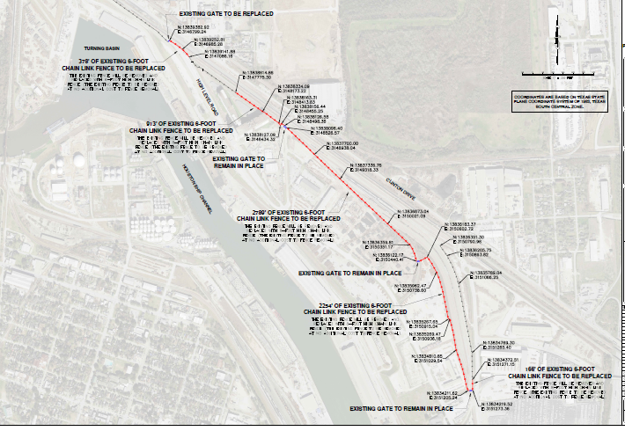
CSB – Perimeter Security Fence TBT

Slide 14
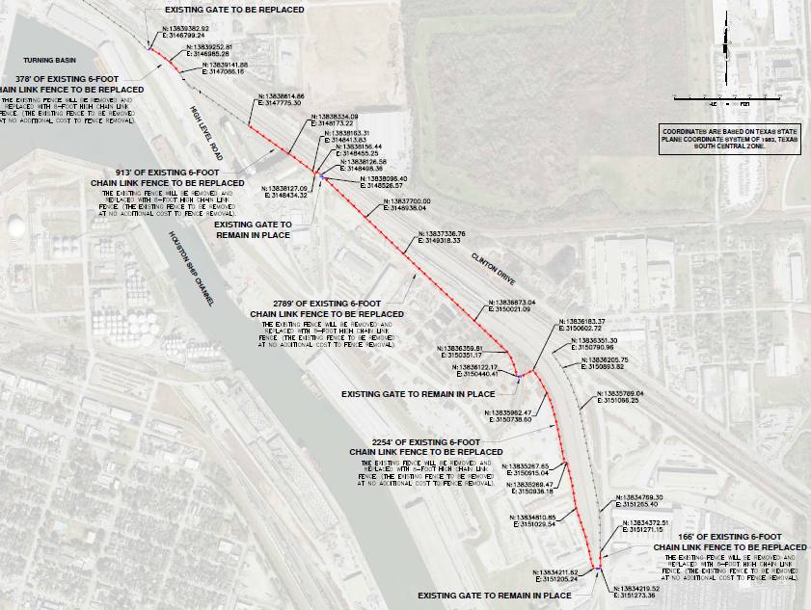
CSB – Perimeter Security Fence TBT

Slide 15
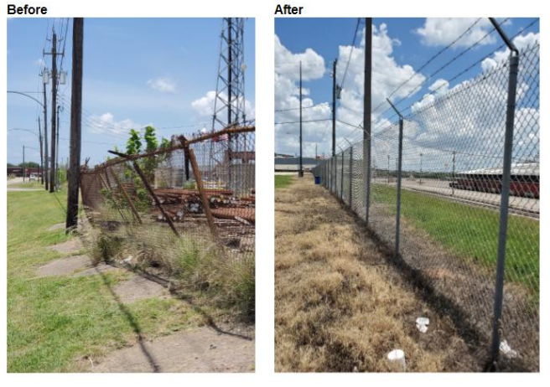
CSB – Perimeter Security Fence TBT

Slide 16
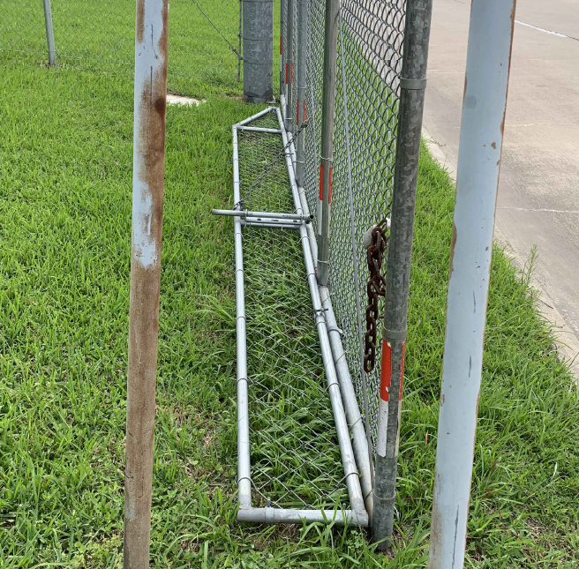
CSB – Perimeter Security Fence TBT
Swing Gate Flaps – Need to be Customized

Slide 17
THANK YOU
Derek Garrett
Project Manager
Port Houston
Questions?
www.PortHouston.com
111 East Loop North
Houston, TX 77029

