Slide 1
Replacement of Windows, Entrance Doors, and Framework at Credit Union at Executive Office at Turning Basin Terminal
Pre-Bid/Proposal Meeting
Brenda C Trevino, PE, PMP
October 25, 2016

Slide 2
Replacement of Windows, Entrance Doors, and Framework at Credit Union at Executive Office at Turning Basin Terminal
Introductions
Harris County – Wage Rate Compliance
Small Business
Procurement
Selection Criteria
Site Parameters – Special Conditions
Questions
All attendees must sign in

Slide 3
Replacement of Windows, Entrance Doors, and Framework at Credit Union at Executive Office at Turning Basin Terminal
PHA Personnel:
Roger H. Hoh, P.E., - Director, Project & Construction Management
Brock Lewis, P.E., - Chief Construction Manager
Brenda C Trevino, P.E., PMP– Project Manager
Pedro Gonzales, P.E., – Small Business Development
Yvette Camel-Smith – Director of Procurement
Harris County:
Robert Rocha - Wage Rate Compliance
Designer:
Eva M. Gomez – Architect (KCI Technologies, Inc.)

Slide 4
Replacement of Windows, Entrance Doors, and Framework at Credit Union at Executive Office at Turning Basin Terminal
Harris County Wage Rate Compliance and Requirements:
Attendance at pre-bid meetings and pre-construction meetings
Review and approve weekly certified payroll records
Monitor wage rate compliance
Review claims of non-compliance from the field and recommend appreciate responses as required or permitted under the Wage Scale Act

Slide 5
Replacement of Windows, Entrance Doors, and Framework at Credit Union at Executive Office at Turning Basin Terminal
Small Business Requirement:
Small Business Participation for this project is a minimum of 15%.
Prime Contractor must meet this hurdle to be considered for the job.
Contact the Small Business Office, if you have difficulty in meeting the Small Business requirement.
PHOTO OR GRAPHIC

Slide 6
Replacement of Windows, Entrance Doors, and Framework at Credit Union at Executive Office at Turning Basin Terminal
Procurement:
Competitive Sealed Bids/Proposals (CSB/CSP) due
November 16, 2016 no later than 11:00 A.M.
One original and five copies packaged in one sealed envelope
All proposals will be opened and ready publicly in the PHA First Floor Conference Room by Procurement Services – Wednesday, November 16th at 11:30 A.M.

Slide 7
Replacement of Windows, Entrance Doors, and Framework at Credit Union at Executive Office at Turning Basin Terminal
Due Wednesday, November 16, 2016
Competitive Sealed Bid /
Proposal Response:
Page 1
General Information
PHOTO OR GRAPHIC

Slide 8
Replacement of Windows, Entrance Doors, and Framework at Credit Union at Executive Office at Turning Basin Terminal
Selection Criteria
The Port Commission will award the contract to the responsible
bidder submitting the lowest and best bid.
Responsible:
1. Meet the applicable Small Business Participation requirements;
2. Have the ability to comply with the required delivery or performance schedule, taking into consideration other business commitments;
3. Have a satisfactory record of performance and integrity;
4. Have a satisfactory safety and environmental record;
5. Have satisfactory references; and
6. Have the necessary facilities, equipment, material, personnel, organization, experience, authorizations, technical skills, and financial resources to fulfill the terms of the contract for
the project.

Slide 9
Replacement of Windows, Entrance Doors, and Framework at Credit Union at Executive Office at Turning Basin Terminal
Due Wednesday, November 16, 2016, no later than 11:00 A.M.:
Competitive Sealed Bid / Proposal Response:
Page 2
Required Attachments
PHOTO OR GRAPHIC

Slide 10
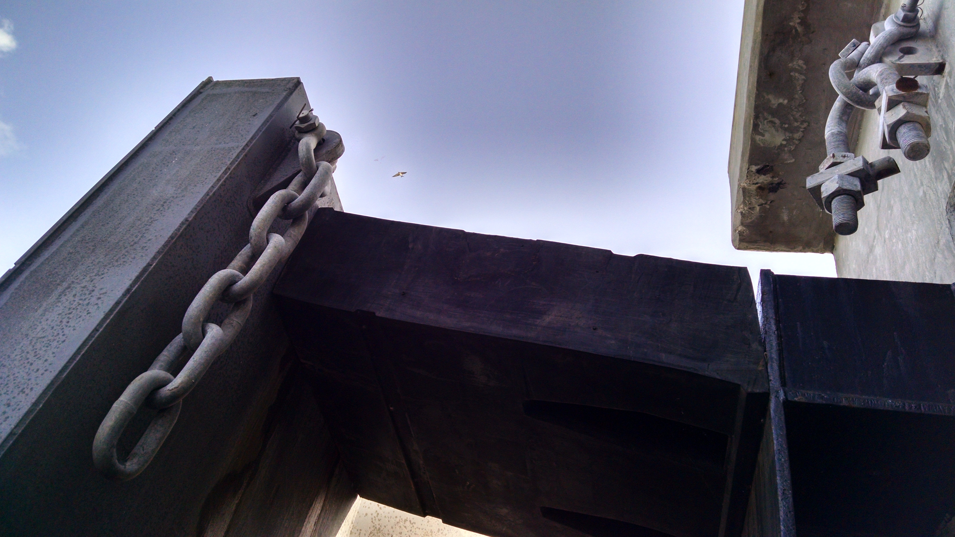
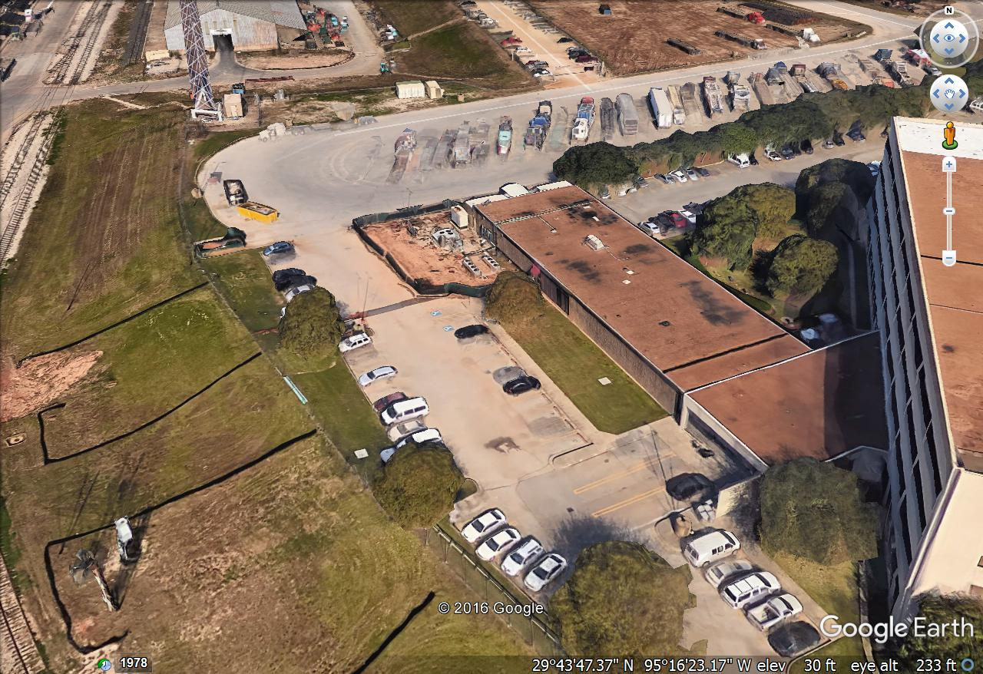
HERE

Slide 11
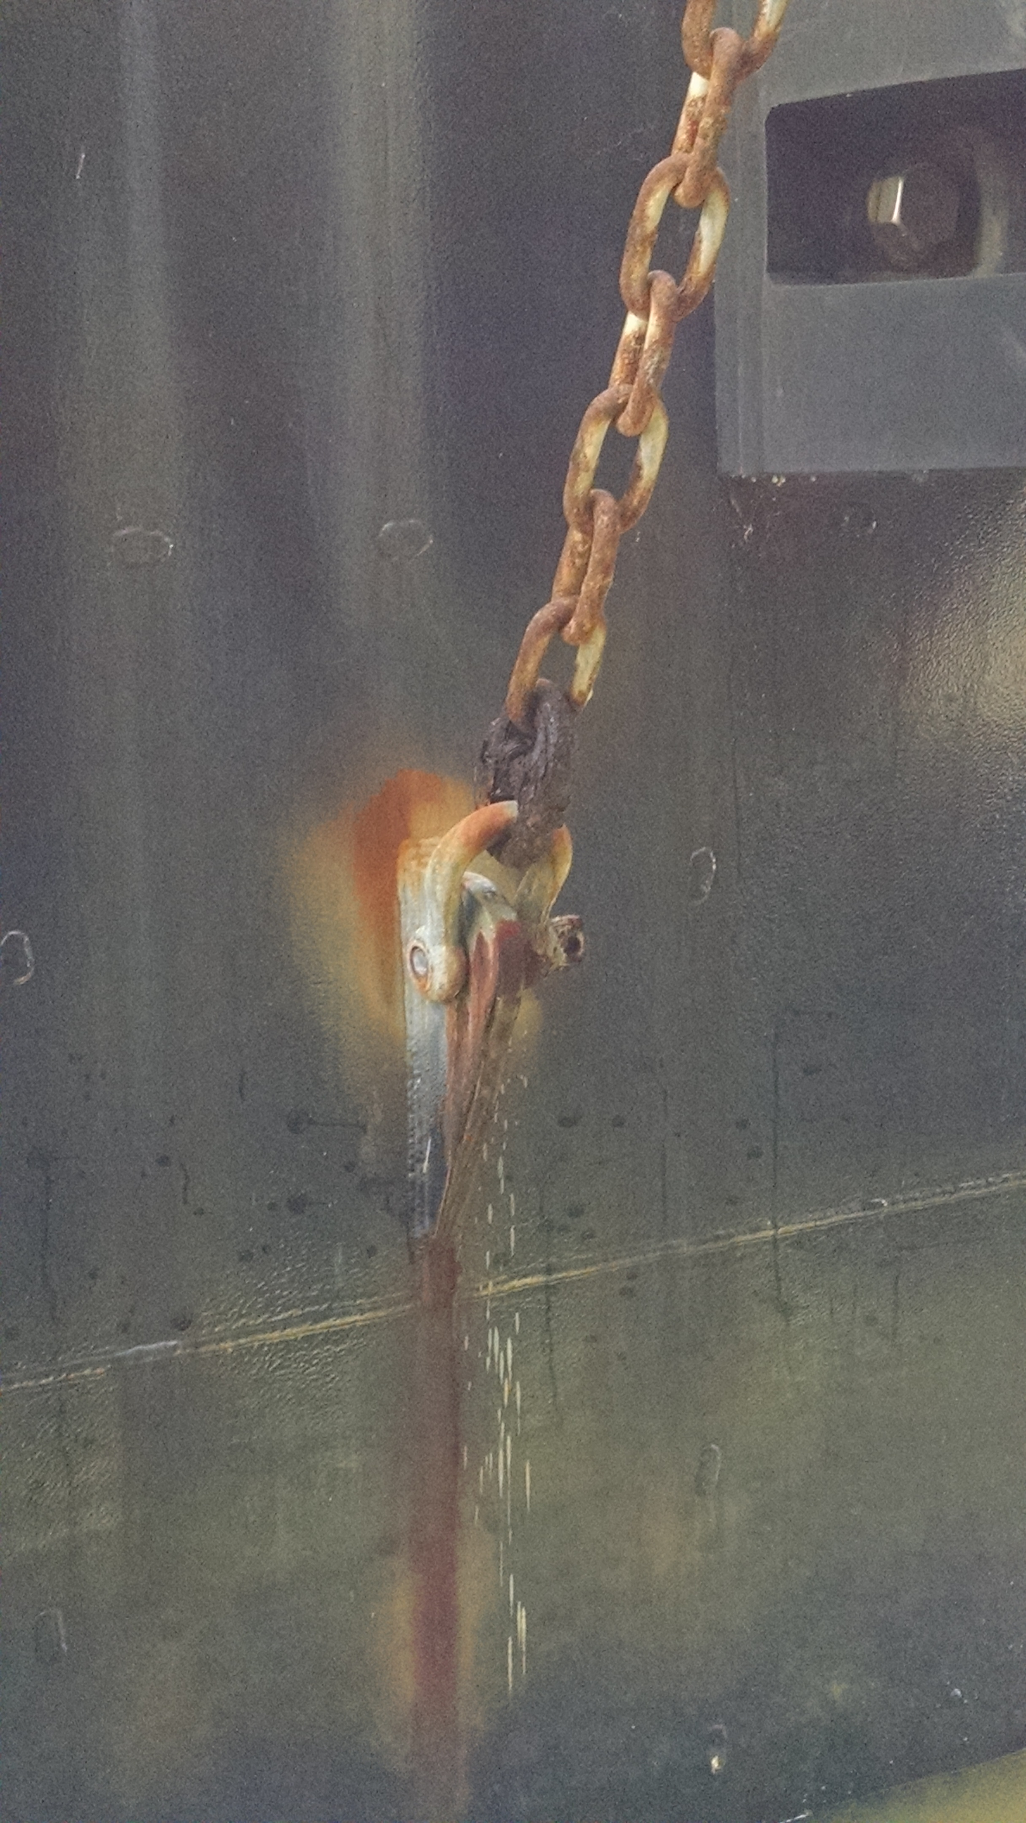
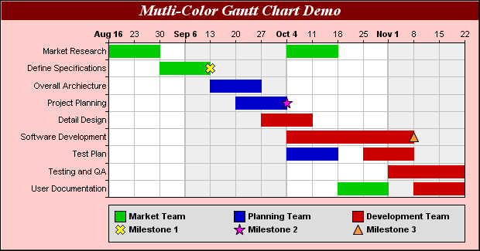
Replacement of Windows, Entrance Doors, and Framework at Credit Union at Executive Office at Turning Basin Terminal
General Scope of Services:
Coordination / scheduling with the Port Authority and its tenant is important
Secure the workspace and keep it from weather intrusion during construction
Remove and dispose of existing windows, framework and entrance doors; and install new
Install window treatments
Provide O&M / Warranty information and as-built drawings.

Slide 12
Replacement of Windows, Entrance Doors, and Framework at Credit Union at Executive Office at Turning Basin Terminal
General Scope of Services (continued):
Additional security will be provided by the Port Authority while the tenant is located in temporary space;
Access to the Credentialing Office must be maintained during regular working hours;
The project will be awarded in January 2017 and the work will begin after Super Bowl weekend;
Proper PPE will be worn at all times;
.

Slide 13
Replacement of Windows, Entrance Doors, and Framework at Credit Union at Executive Office at Turning Basin Terminal
No photographs – leave cell phones in your pockets or purses!
Stay with group
Comply with your company’s safety
policy!

Slide 14
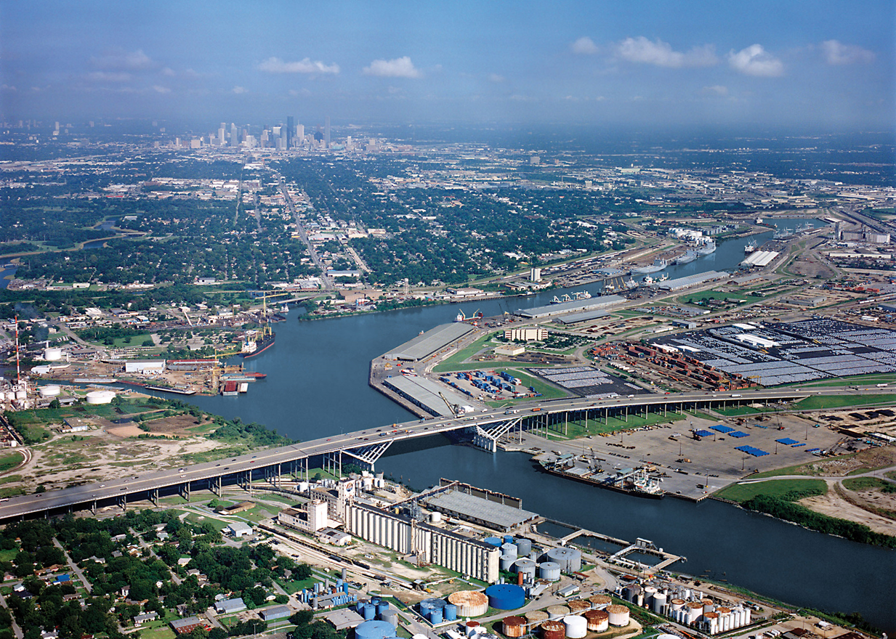
QUESTIONS?
Thank You
&
Questions

