Slide 1
Bi-Annual Pavement, Drainage & Dust Control Work at Industrial Park East 2017-2018
Pre-Bid/Proposal Meeting
Brenda C Trevino, PE, PMP
October 18, 2016

Slide 2
Bi-Annual Pavement, Drainage & Dust Control Work at Industrial Park East 2017-2018
Introductions
Harris County – Wage Rate Compliance
Small Business
Procurement
Selection Criteria
Site Parameters – Special Conditions
Questions
All attendees must sign in

Slide 3
Bi-Annual Pavement, Drainage & Dust Control Work at Industrial Park East 2017-2018
PHA Personnel:
Roger H. Hoh, P.E., - Director, Project & Construction Management
Brock Lewis, P.E., - Chief Construction Manager
Brenda C Trevino, P.E., PMP– Project Manager
Pedro Gonzales, P.E., – Small Business Development
Yvette Camel-Smith – Director of Procurement
Harris County:
Robert Rocha - Wage Rate Compliance

Slide 4
Bi-Annual Pavement, Drainage & Dust Control Work at Industrial Park East 2017-2018
Harris County Wage Rate Compliance and Requirements:
Attendance at pre-bid meetings and pre-construction meetings
Review and approve weekly certified payroll records
Monitor wage rate compliance
Review claims of non-compliance from the field and recommend appreciate responses as required or permitted under the Wage Scale Act

Slide 5
Bi-Annual Pavement, Drainage & Dust Control Work at Industrial Park East 2017-2018
Small Business Requirement:
Small Business Participation for this project is a minimum of 15%.
Prime Contractor must meet this hurdle to be considered for the job.
Contact the Small Business Office, if you have difficulty in meeting the Small Business requirement.
PHOTO OR GRAPHIC

Slide 6
Bi-Annual Pavement, Drainage & Dust Control Work at Industrial Park East 2017-2018
Procurement:
Competitive Sealed Bids/Proposals (CSB/CSP) due
October 26, 2016 no later than 11:00 A.M.
One original and five copies packaged in one sealed envelope
All proposals will be opened and ready publicly in the PHA First Floor Conference Room by Procurement Services – Wednesday, October 26th at 11:30 A.M.

Slide 7
Bi-Annual Pavement, Drainage & Dust Control Work at Industrial Park East 2017-2018
Due Wednesday, October 26, 2016 no later than 11:00 A.M.:
Competitive Sealed Bid /
Proposal Response:
Page 1
General Information
PHOTO OR GRAPHIC

Slide 8
Bi-Annual Pavement, Drainage & Dust Control Work at Industrial Park East 2017-2018
Selection Criteria
The Port Commission will award the contract to the responsible
bidder submitting the lowest and best bid.
Responsible:
1. Meet the applicable Small Business Participation requirements;
2. Have the ability to comply with the required delivery or performance schedule, taking into consideration other business commitments;
3. Have a satisfactory record of performance and integrity;
4. Have a satisfactory safety and environmental record;
5. Have satisfactory references; and
6. Have the necessary facilities, equipment, material, personnel, organization, experience, authorizations, technical skills, and financial resources to fulfill the terms of the contract for
the project.

Slide 9
Bi-Annual Pavement, Drainage & Dust Control Work at Industrial Park East 2017-2018
Due Wednesday, October 26, 2016, no later than 11:00 A.M.:
Competitive Sealed Bid / Proposal Response:
Page 2
Required Attachments
PHOTO OR GRAPHIC

Slide 10
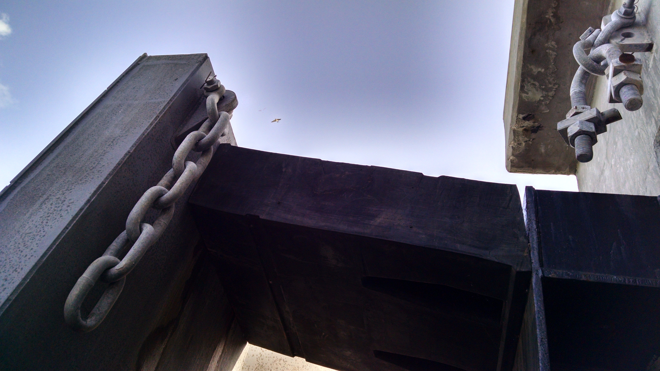
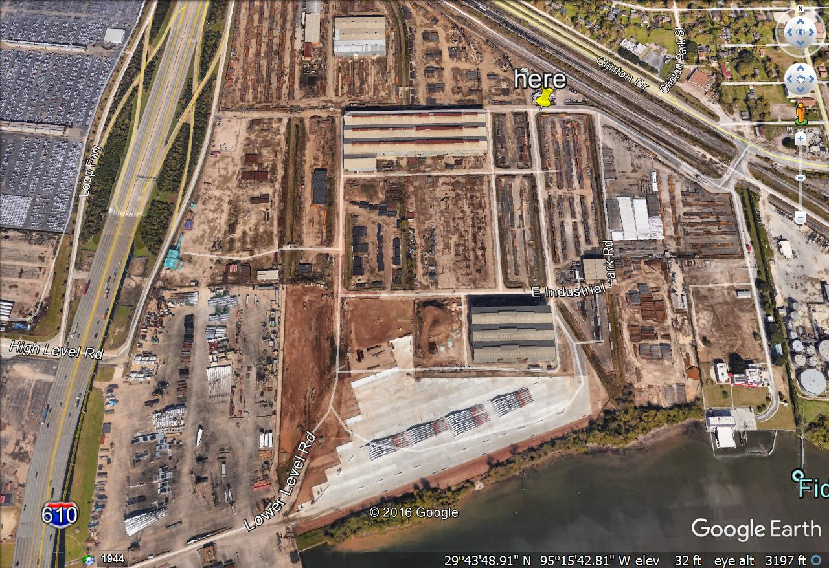
at Industrial Park East 2017-2018
HERE

Slide 11
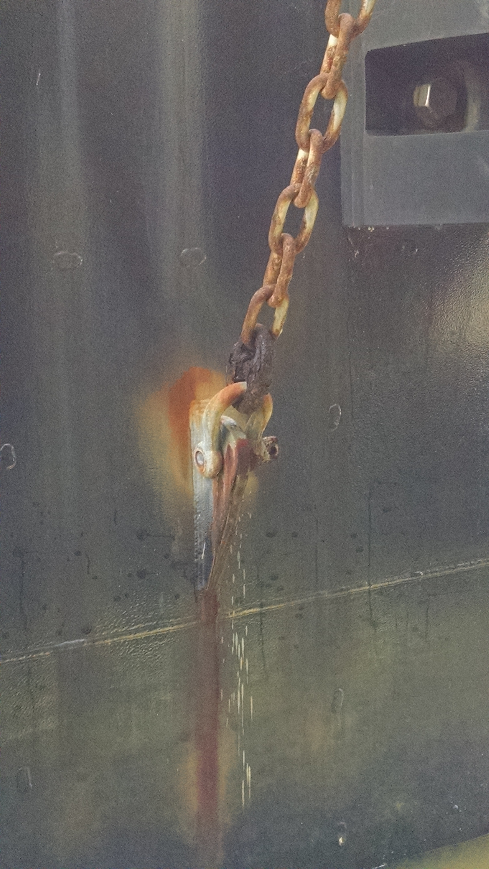
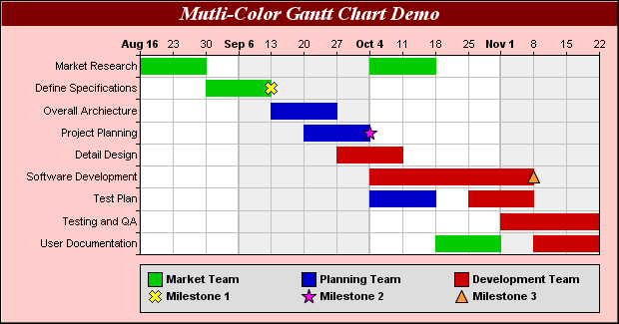
Bi-Annual Pavement, Drainage & Dust Control Work at Industrial Park East 2017-2018
General Scope of Services:
Remove, install and monitor BMPs as appropriate;
Prepare, repair potholes and pave new areas with asphalt;
Clean out drainage ditches, culverts and inlets;
Remove and dispose of excess soil on PHA property;
Spray emulsified asphalt, when and where required;
A schedule will be required for all parts of the work except the spraying of the emulsified asphalt.

Slide 12
Bi-Annual Pavement, Drainage & Dust Control Work at Industrial Park East 2017-2018
General Scope of Services (continued):
Work accommodates tenants and weather;
No work expected inside the secure area;
Proper PPE will be worn at all times;
Work is for 2 years (not divisible) Half for 2017, half for 2018
.

Slide 13
Bi-Annual Pavement, Drainage & Dust Control Work at Industrial Park East 2017-2018
No photographs – leave cell phones in your pockets or purses!
Stay with group
Safety vests, hard hat, safety glasses
No open-toed shoes
Comply with your company’s safety policy!

Slide 14
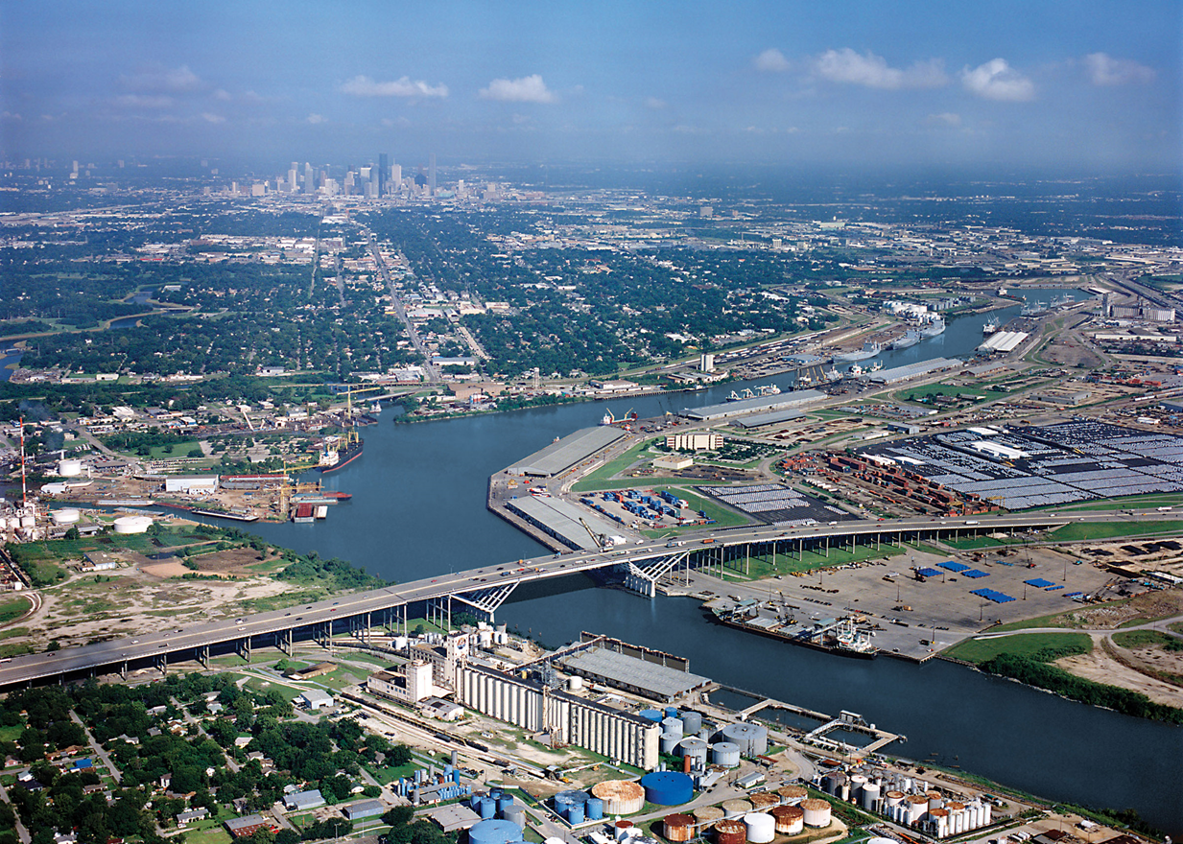
QUESTIONS?
Thank You
&
Questions

