Slide 1
Pre-Bid Meeting for CSB-1602 Purchase of Batteries- Portwide
Jason Cox | Asst. Maintenance Manager | BPT Maintenance
August 25, 2020 at 10:00 a.m.

Slide 2
Pre-Bid Meeting House Rules
Attendees will begin the meeting in listen-only mode.
There will be a Q&A session at the end of today’s presentation.
If you have any questions during the presentation, you may submit your Questions through the WebEx chat feature and they will be addressed at the end of the presentation.

Slide 3
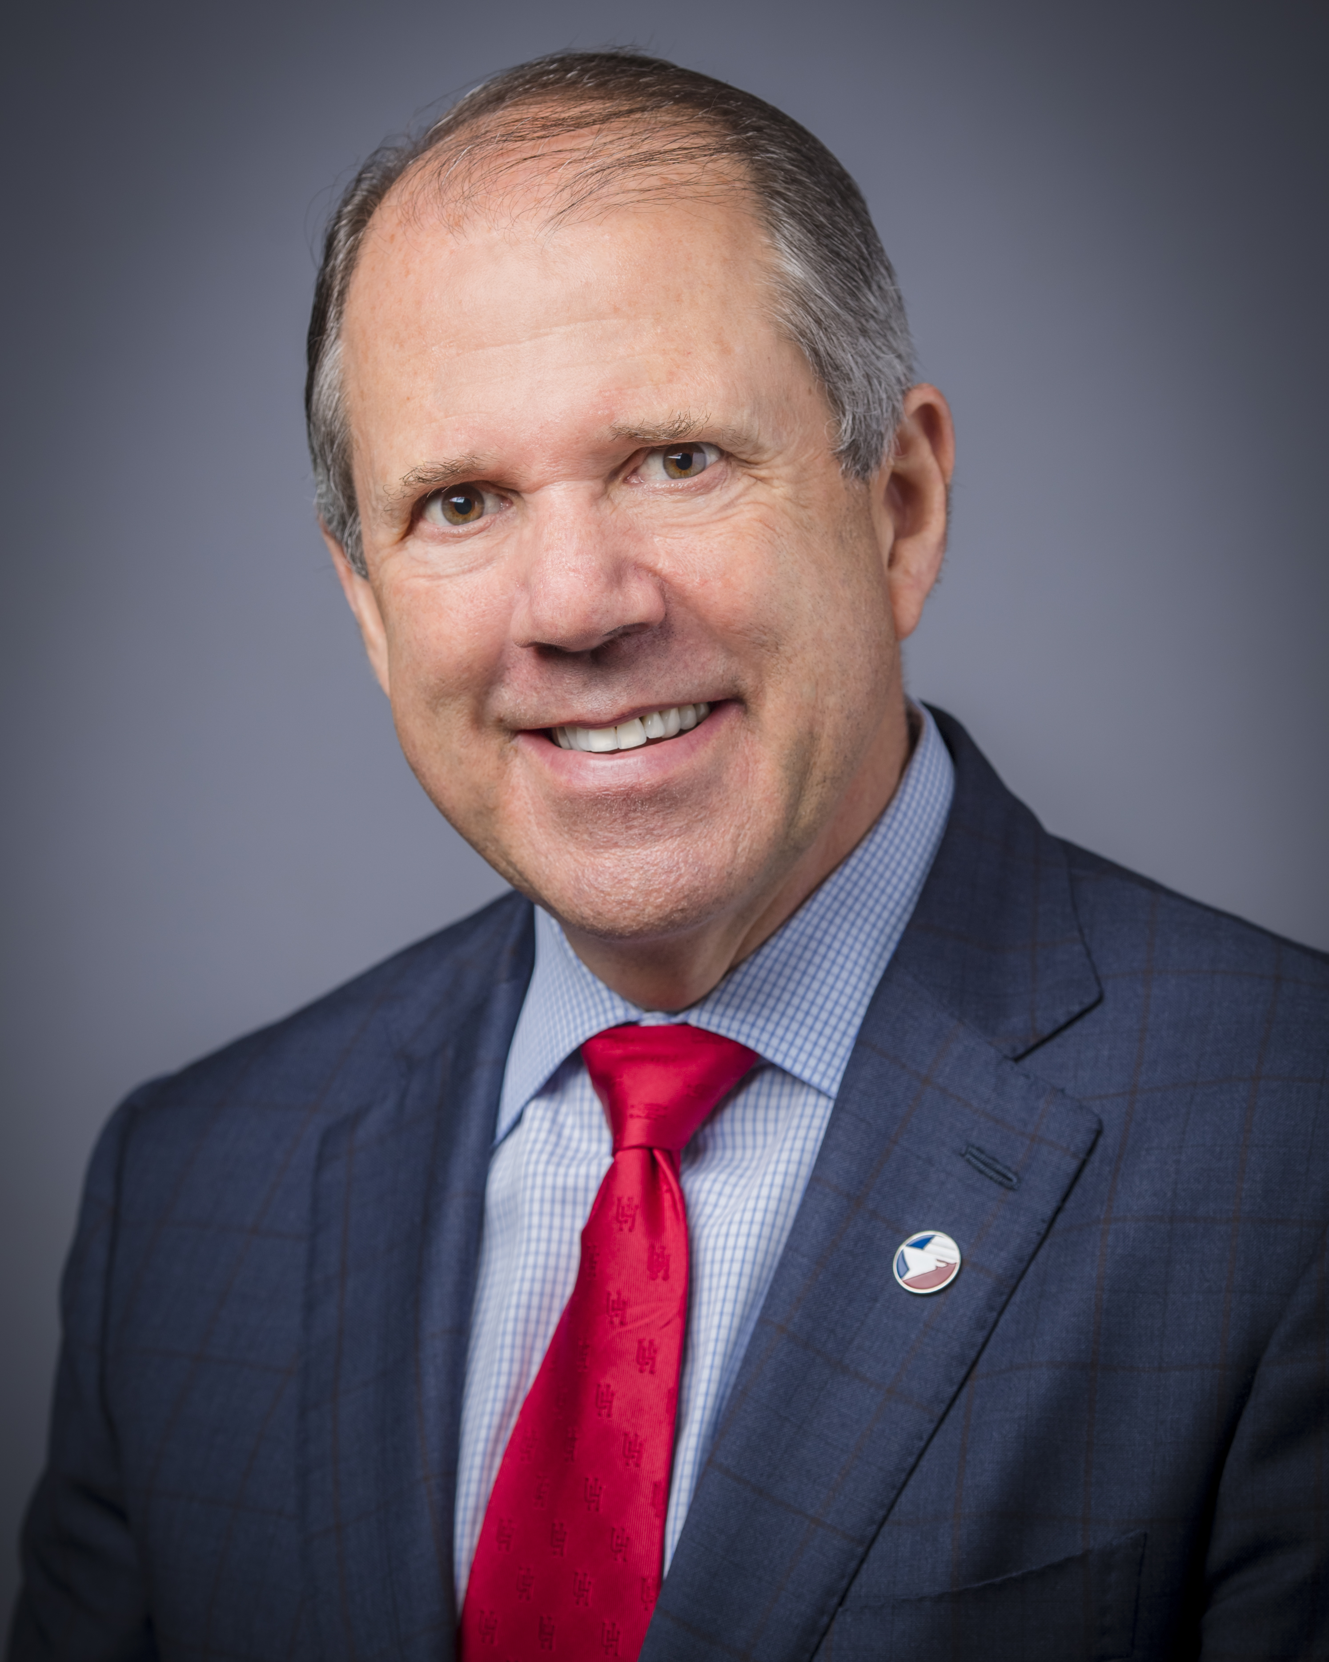
Port Commission
Dean E. Corgey
Clyde Fitzgerald
Cheryl D. Creuzot
Rick Campos
Chairman
Stephen H. DonCarlos
Roy D. Mease
Wendy Montoya
Cloonan
WELCOME MESSAGE | 2

Slide 4
CSB-1602 Purchase of Batteries- Portwide
AGENDA
Introductions
Procurement
Project Scope Review
Questions

Slide 5
CSB-1602 Purchase of Batteries- Portwide
Procurement:
Release Date: August 12, 2020
Proposals Due: September 16, 2020, no later than 11 a.m. (CST)
Proposers submit their proposals electronically via email to:
Procurementproposals@porthouston.com
Anticipated Award Date: October 27, 2020
“No Contact Period”

Slide 6
CSB-1602 Purchase of Batteries- Portwide
Selection Criteria
The Port Commission will award the contract to the responsible bidder submitting the lowest and best bid. In determining whether a bidder qualifies as “responsible” (i.e., eligible for award), a number of factors, including but not limited to the following, may be considered. A responsible bidder should:
1. have the ability to comply with the required delivery or performance schedule, taking into consideration other business commitments;
2. have a satisfactory record of performance and integrity;
3. have a satisfactory safety and environmental record; and
4. have satisfactory references; and
5. have the necessary facilities, equipment, material, personnel, organization, experience, authorizations, technical skills, and financial resources to fulfill the terms of the contract for the Project.

Slide 7
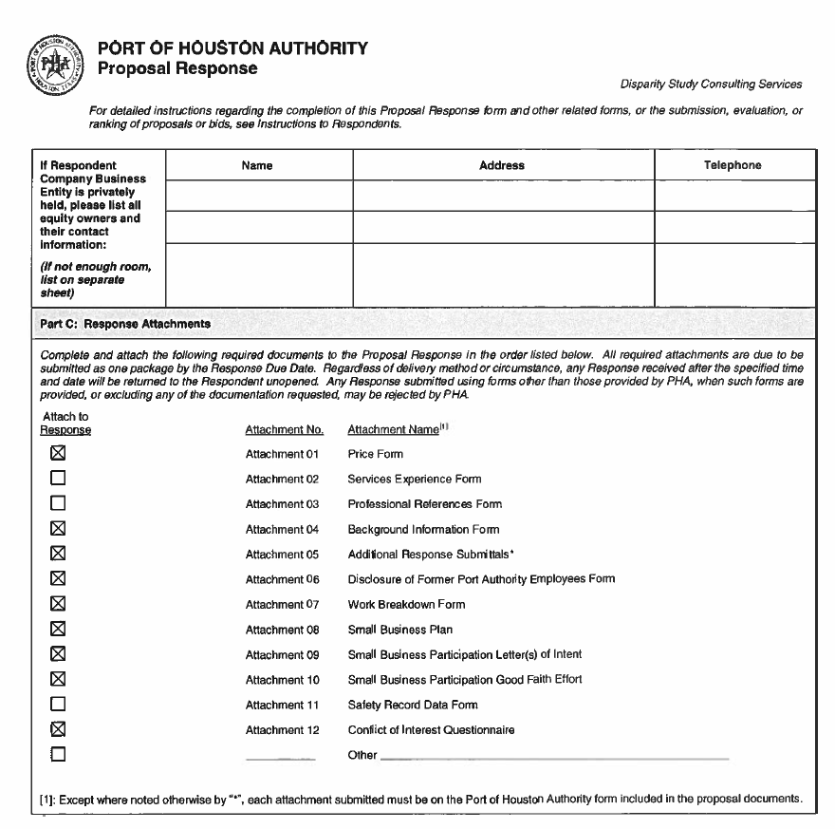
CSB-1602 Purchase of Batteries- Portwide
Proposal Response:
Page 32 – Required Attachments

Slide 8
CSB-1602 Purchase of Batteries- Portwide
Overview of Project:
This project consists of the following:
Provide batteries to the Barbours Cut Terminal, Bayport Container Terminal, and Turning Basin Terminal on an as needed basis in accordance with the Technical Specifications found in the solicitation package.
All batteries furnished under this Contract must be manufactured by ACDELCO and carry their label and ACDELCO warranty.
No substitutions will be permitted.

Slide 9
CSB-1602 Purchase of Batteries- Portwide
Overview of Project (Cont.d):
Respondent shall attach the core policy or “return for credit” policy regarding battery type and conditions to the proposal submission.
This is a nondivisible bid. Failure to bid on all line items shown on Exhibit A: Price Exhibit may result in rejection of the Response.
Deliveries shall be made to the below facilities in accordance with the delivery times. Freight charges shall be prepaid and included in the bid price. Delivery locations:
• Bayport, 12703 Port Rd, Seabrook, TX 77586
• Barbours Cut, 1819 E. Barbours Cut Blvd, La Porte, TX 77571
• Turning Basin, 111 East Loop North, Houston, TX 77029
Contract Time-Two (2) years

Slide 10
THANK YOU
Questions?
https://buyspeed.poha.com
Or
procurementproposals@porthouston.com

