Slide 1
Replacement of Ramp Road 7 Speed Gate at Turning Basin
Derek L. Garrett | Project Manager | Project & Construction Management (PCM)

Slide 2
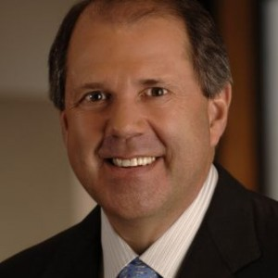
Port Commission
John D. Kennedy
Dean E. Corgey
Clyde Fitzgerald
Rick Campos
Chairman
Theldon R. Branch, III
Stephen H. DonCarlos
Roy D. Mease
WELCOME MESSAGE | 2

Slide 3
Replacement of Ramp Road 7 Speed Gate at Turning Basin
AGENDA
Introductions
Harris County
Small Business
Procurement Services
Selection Criteria
Site Parameters
Questions
Site Visit

Slide 4
Replacement of Ramp Road 7 Speed Gate at Turning Basin
PHA Personnel:
Roger H. Hoh, P.E. – Director, PCM
Ross Talbot, P.E. – Construction Manager
Derek L. Garrett – Project Manager
Randy Stiefel – Director, General Cargo Facilities
Yvette Camel-Smith – Director, Procurement Services
Pedro Gonzalez, P.E. – Small Business Manager
Jessica Thomas – Security Director
Harris County:
Robert Rocha – Wage Rate Monitor

Slide 5
Replacement of Ramp Road 7 Speed Gate at Turning Basin
Harris County Wage Rate Compliance & Requirements:
Attendance at pre-bid/proposal meetings and pre-construction meetings
Review and approve weekly certified payroll records
Monitor wage rate compliance
Review claims of non-compliance from the field and recommend appreciate responses as required or permitted under the Wage Scale Act

Slide 6
Replacement of Ramp Road 7 Speed Gate at Turning Basin
Small Business Requirements:
Minimum Pass/Fail Small Business requirement of 30%

Slide 7
Replacement of Ramp Road 7 Speed Gate at Turning Basin
Procurement:
Competitive Sealed Bids (CSB) are due on Nov. 6, 2019, no later than 11:00 A.M.
One original and five copies, packaged in one sealed envelope
All proposals will be opened and read publicly in the PHA first floor conference room by Procurement Services on Wednesday, Nov. 6, 2019 at 11:30 A.M.

Slide 8
Replacement of Ramp Road 7 Speed Gate at Turning Basin
Selection Criteria
The Port Commission will award the contract to the responsible bidder submitting the lowest and best bid.
Responsible:
Meet the applicable Small Business Participation requirements
Have the ability to comply with the required delivery or performance schedule, taking into consideration other business commitments;
Have a satisfactory record of performance and integrity;
Have satisfactory safety and environmental record;
Have satisfactory references; and
Have the necessary facilities, equipment, materials, personnel, organization, experience, authorizations, technical skills, and financial resources to fulfill the terms of the contract for the project

Slide 9
Replacement of Ramp Road 7 Speed Gate at Turning Basin
Competitive Sealed Bid Response:
Page 2 – Required Attachments

Slide 10
Replacement of Ramp Road 7 Speed Gate at Turning Basin
General Scope of Services:
Demolition and salvage of existing speed gate
Fabrication and delivery of new speed gate
Installation of new speed gate
Contract Time = 120 Days

Slide 11
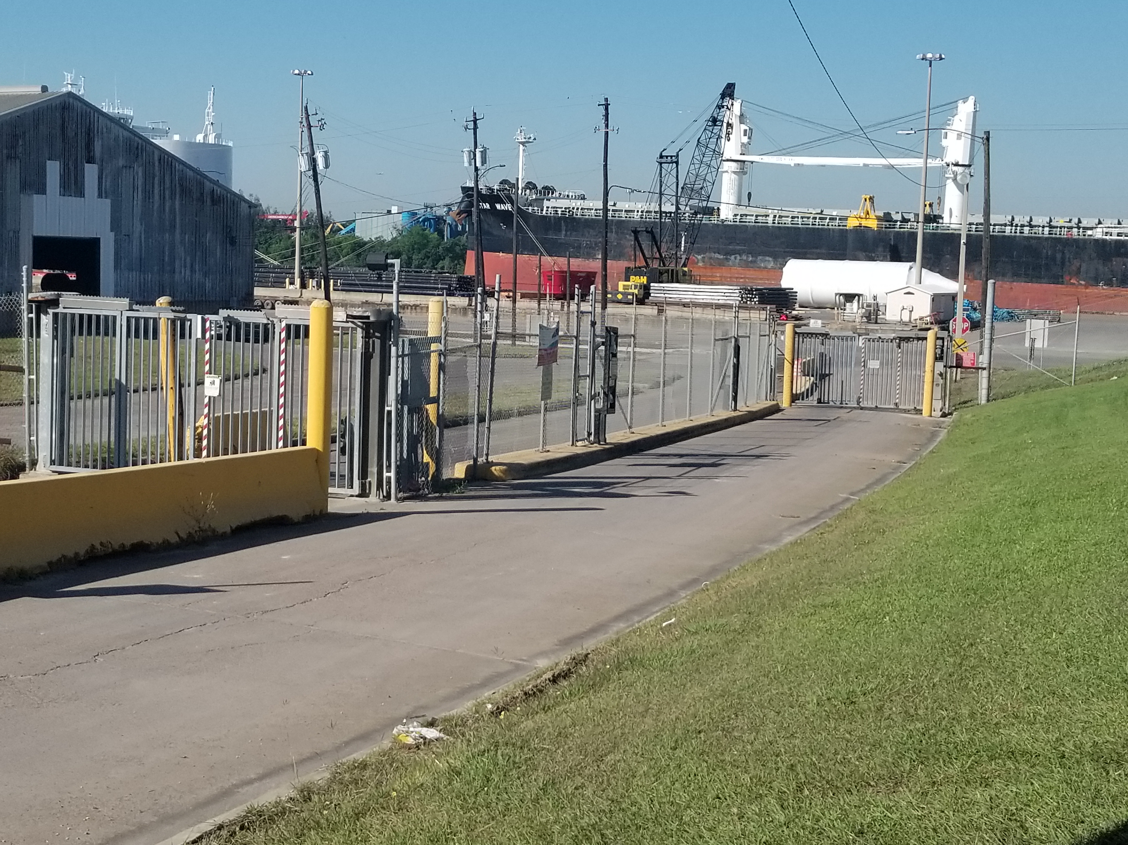
Replacement of Ramp Road 7 Speed Gate at Turning Basin

Slide 12
THANK YOU
Derek Garrett
Project Manager
Port Houston
Questions?
www.PortHouston.com
111 East Loop North
Houston, TX 77029

