Slide 1
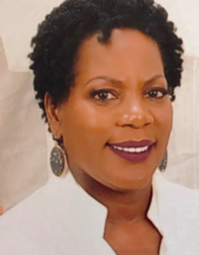
Pre-Proposal Conference:
CSP-2296 Wharf and RTG Crane Painting at Barbours Cut Terminal Bayport Container Terminal
August 2, 2022
2:00 p.m.
PORT HOUSTON
Barbara H. Smith, P.E., MBA, Project Manager

Slide 2
AGENDA
Pre-Proposal Conference House Rules
Introductions
Harris County
Business Equity
Procurement Services
Selection Criteria
Questions

Slide 3
PRE-PROPOSAL CONFERENCE HOUSE RULES
Attendees will begin the meeting in listen-only mode.
There will be a Q&A session at the end of today’s presentation.
If you have any questions during the presentation, you may submit your Questions through the WebEx Q&A feature and they will be addressed at the end of the presentation.
This presentation recording will be posted on the BuySpeed homepage under “Pre-Bid/Proposal Conference Information.”

Slide 4
PORT COMMISSION
Dean E. Corgey
Commissioner
Clyde Fitzgerald
Commissioner
Stephen H. DonCarlos
Commissioner
Ric Campo
Chairman of the Port Commission
Roy D. Mease
Commissioner
Wendy Montoya Cloonan
Commissioner
Cheryl D. Creuzot
Commissioner
Notes:
So let’s talk about Port Houston. First, we are governed by a seven-member Commission, led by Chairman Ric Campo.

Slide 5
PHA Personnel:
Roger H. Hoh, P.E. – Director, PCM
Barbara H. Smith, P.E. – Project Manager
Oscar Zavala – Construction Manager
Brenda Ruiz – Business Equity
Yvette Camel-Smith – Director, Procurement
Dean Ainuddin – Manager Contracts, Procurement
Harris County:
Robert Rocha - Wage Rate Monitor
Dannenbaum Engineering Corp.:
Michael Alberto – Consultant

Slide 6
Harris County Wage Rate Compliance & Requirements:
Attendance at pre-bid/proposal meetings and preliminary meetings
Review and approve weekly certified payroll records
Monitor wage rate compliance
Review claims of non-compliance from the field and recommend appropriate responses as required or permitted under the Wage Scale Act

Slide 7
BUSINESS EQUITY
Supplier Diversity Manager

Slide 8
BUSINESS EQUITY
S/MWBE INITIATIVE
Business Equity Division provides resources to small, minority- and woman-owned businesses (S/MWBE) seeking to participate in Port Houston procurements and contracts.
Port Houston promotes business opportunities for all sectors of the community and recognizes the importance of vendor and suppler diversity in its contracts.
Port Houston has established an organizational ​35% Small Business participation goal and a​ 30% Minority-and Woman Business Enterprise (MWBE) aspirational goal.
35%
SBE participation goal
30%
MWBE aspirational goal

Slide 9
BUSINESS ENTERPRISE DEFINITIONS
Small Business Enterprise (SBE)
Gross revenues or number of employees, averaged over the past three years does not exceed the size standards defined by SBA.
The net worth of the owner must be less than $1.32 million, excluding the owner’s primary residence and assets of the business.
Minority Business Enterprise (MBE)
At least 51% Owned by one or more Minority Individuals, or at least 51% of the equity is Owned by one or more Minority Individuals.
Both the management and daily business operations are carried out and controlled by one or more of the Minority Individuals who own it.
Woman-Owned Business Enterprise (WBE)-
At least 51% Owned by one or more Women, or at least 51% of the equity is Owned by one or more Women
Both the management and daily business operations are carried out and controlled by one or more of the Women who own it.
Notes:
As a contractor Contractor you are agrees to:
• Placing qualified S/MWBEs on solicitation lists; S/MWBEs must perform a Commercially Useful Function (CFU) to be counted towards goals. CANNOT BE A PASS THROUGH

Slide 10
CERTIFYING PARTNERS
Small and M/WBEs must meet certain criteria and be certified with one of the following partner agencies:
City of Houston *
Houston Minority Supplier Development Council
METRO *
National Minority Supplier Development Council & Affiliates
Small Business Administration 8(a) *
South Central Texas Regional Certification Agency – SCTRCA *
Texas Comptroller of Public Accounts – HUB Certification
Texas Department of Transportation – TxDOT *
Women’s Business Enterprise Alliance
Women’s Business Enterprise National Council & Affiliates – WBENC
* No fee to apply
Notes:
Port Houston is not a certifying entity but we accept the certifications from our certifying partners . Meeting the certification requirements for any of the listed partners is a requirement to be part of the Port of Houston S/MWBE Program. After certification has been verified, interested business must complete an enrollment process to be inducted into the S/MWBE Program.

Slide 11
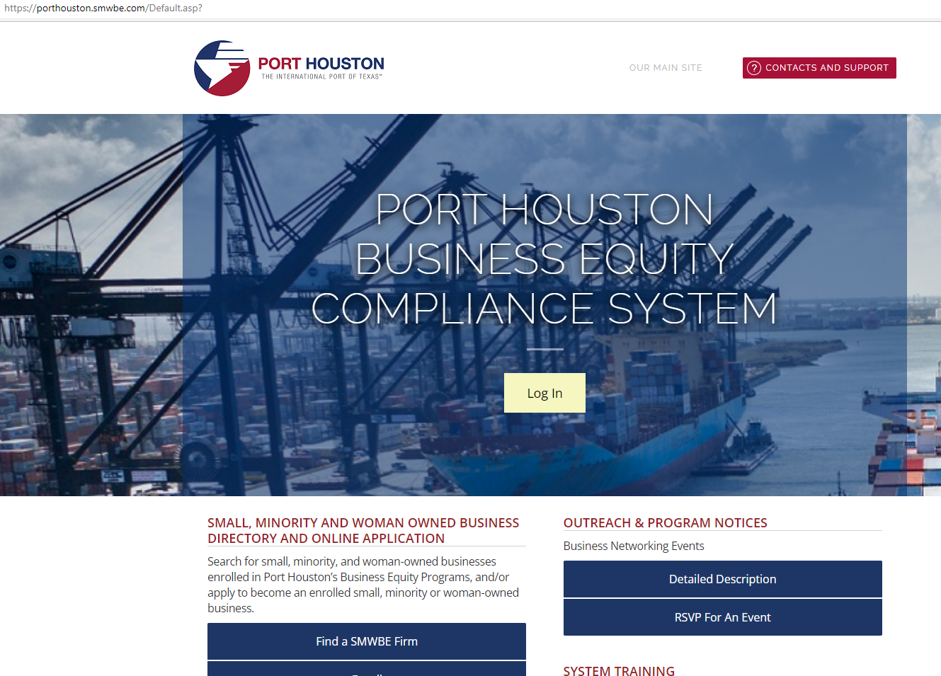
PORT HOUSTON S/MWBE ENROLLMENT DIRECTORY
How do I identify Port Houston enrolled small,
minority- and woman-owned businesses
(S/MWBE)?
Search for businesses in 2 easy steps:
1. Visit https://porthouston.smwbe.com Under the section on the
left labeled Small, Minority and Woman Owned Business
Directory and Online Application select the blue button labeled,
"Find a S/MWBE Firm".
2. You will need to complete at least one of the fields in the popup
window titled, Port Houston S/MWBE Enrollment Directory
and Search.
www.porthouston.smwbe.com
Notes:
Search for small, minority, and woman-owned businesses enrolled in Port Houston’s Business Equity Programs
NAIC Codes
Download our directory.

Slide 12
TIPS TO INCREASE PARTICIPATION
Establish relationships with S/MWBE’s in advance ​
Assuring that S/MWBEs are solicited whenever they are potential sources; ​
Subdivide the work, when economically feasible, into smaller tasks or quantities to permit maximum participation by S/MWBE’s;​
Use the Port of Houston Directory.
Advertise opportunities
Offer assistance and use the services and assistance, as appropriate, of such organizations as the Small Business Administration and the Minority Business Development Agency of the Department of Commerce.​
What subcontractors have you done business in the past and do they qualify?
Notes:
As a contractor Contractor you are agrees to:
• Placing qualified S/MWBEs on solicitation lists; S/MWBEs must perform a Commercially Useful Function (CFU) to be counted towards goals. CANNOT BE A PASS THROUGH

Slide 13
BUSINESS EQUITY CONTRACT REQUIREMENTS
This project is does not have any Business Equity requirements, but we highly encourage the use of small, minority- and woman-owned business when possible.
All dollars awarded and committed to enrolled S/MWBEs count towards Port Houston's S/MWBE goals regardless of whether the individual solicitation includes criteria for small, minority, woman-owned business participation.

Slide 14
PROCUREMENT
Dean Ainuddin, CPP, MBA, Manager Contracts

Slide 15
PROCUREMENT
No Contact Period – No communication between interested vendors and Port Houston staff during the active period.
Technical questions should be submitted via BuySpeed
Last day to submit questions: 7 days before due date (8/3/2022)
Responses are due no later than 11 a.m. on 8/10/2022
Proposals must be submitted electronically via email to: procurementproposals@porthouston.com
Use forms in the package
Anticipated award date: 9/27/2022

Slide 16
EVALUATION CRITERIA
Port Houston will select the provider of the services offering the best value to Port Houston. The criteria and relative weights that will be considered by Port Houston in evaluating each Response are as follows:
CRITERIA | RELATIVE WEIGHT (%)
Price | 45
Vendor's Reputation, Quality of Services, Safety Record | 35
Benefit to Port Authority | 15
Overall Compliance with Port Authority Policies | 5

Slide 17
DOCUMENT CHECKLIST
Proposal Response form:
(Page 31 of CSP Document)
Page 2 of the Proposal Response Form – Required Attachments

Slide 18
SCOPE OF WORK OVERVIEW

Slide 19
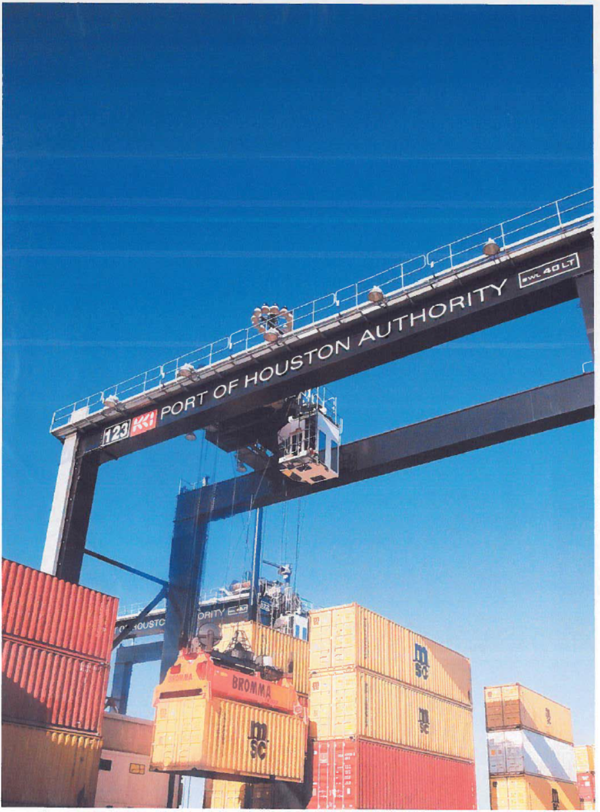
General Scope of Services
"On-Call" Project for crane recoating for:
Rubber Tire Gantry (RTG) cranes at Barbour's Cut and Bayport Container Terminals.
50 foot guage Container Cranes at Wharves 4, 5, and 6 at Barbour's Cut Terminal
100 foot guage Container Cranes at Wharves 1, 2, and 3 at Barbour's Cut Terminal
100 foot guage Container Cranes at Bayport Terminal
Contractor shall be available on an "as-need" basis when called upon by PHA.
For each "call-out", the Contractor shall meet on-site for work task and milestone direction from PHA inspector.
Sequence of operations and access to work shall be per PHA direction as dictated by Special Conditions and other related Contract Documents and field direction

Slide 20
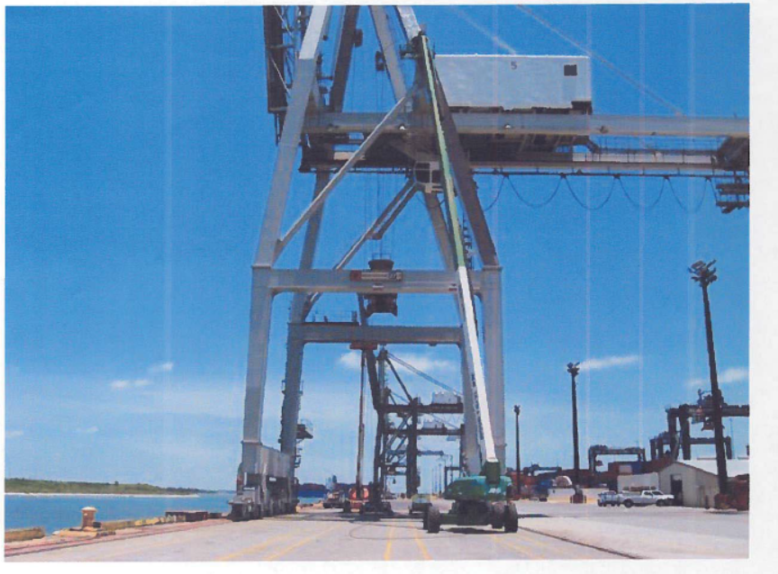
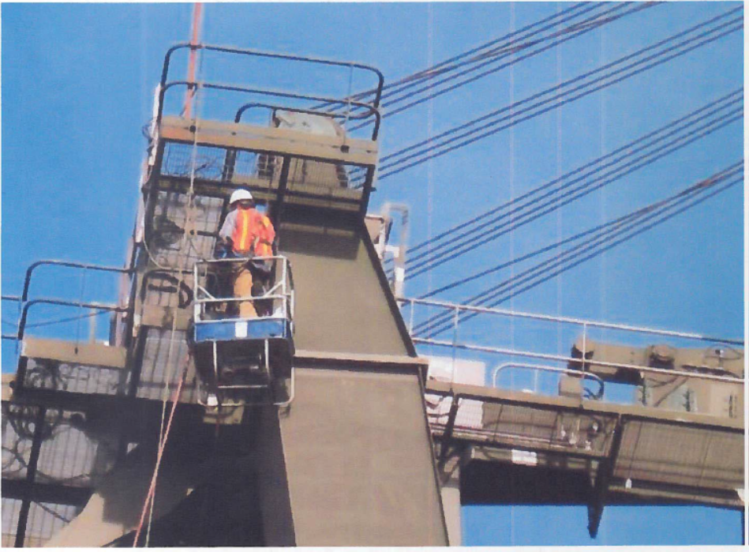
General Scope of Services (continued)
Furnish all labor, materials, equipment, services and incidentals necessary to:
Access work areas (60 to 150+ feet high, lifts and OSHA fall protection, etc., as required)
Perform surface preparation on interior and exterior surfaces
Apply coatings to interior and exterior crane surfaces
Prep and apply coatings to all surfaces directed by PHA
PHA shall direct what surfaces are to be excluded (gear boxes, motors, etc.)

Slide 21
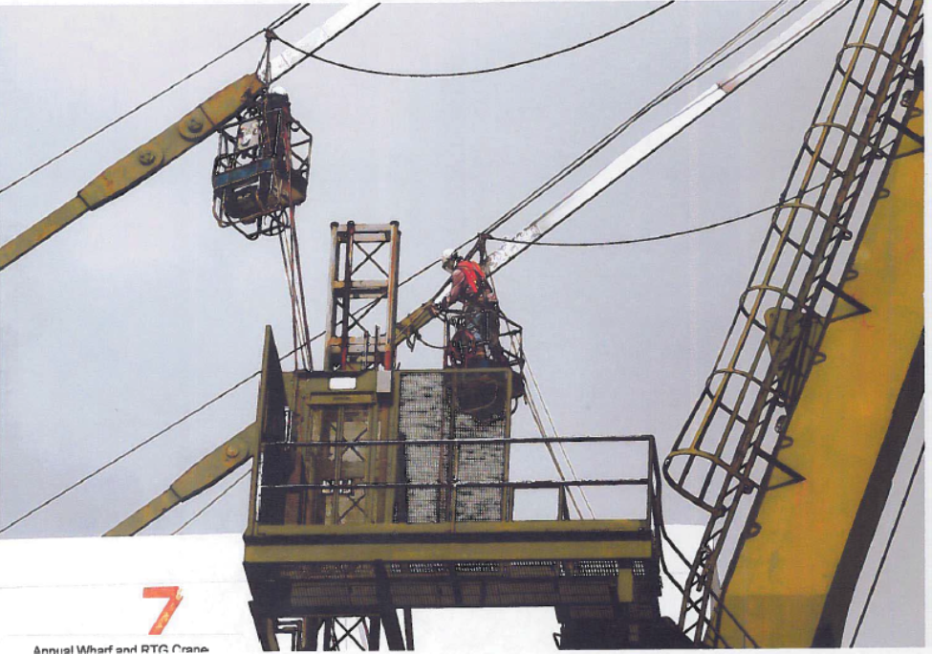
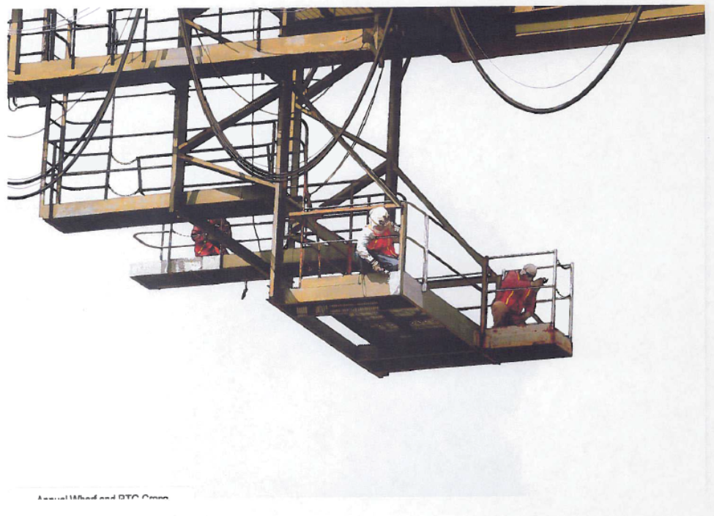
General Scope of Services (continued)
Existing paint may contain lead-based paint or other toxic metals, therefore
Contractor is expected to comply with OSHA requirements for monitoring and adjust accordingly
And strictly comply with all Federal, State, and Local laws and rules for handling and disposal
Contractor is expected to comply with all preparation, application, and testing requirements noted in the Contract Technical Specifications
Material Data sheets for all material shall be made available to PHA and material handled accordingly
Respondents are to rely on their own estimates and material take-off for project bidding/proposing.

Slide 22
Procurement Services
Email: procurement@porthouston.com
Phone: (713) 670- 2464
QUESTIONS?
PORT HOUSTON

